Slide 1

EXL Overview
April 2025

Slide 2










EXL is a trusted partner to Fortune 500 organizations
About EXL
S&P Midcap
NASDAQ: EXLS
$2B+
FY 2025 revenue guidance
65%+
Revenue from insurance
9,000+
Digital & Data professionals
800+
Global clients
Global Operations
Cloud-Native AI Solutions
Insurance (550+ clients)
Banking and Financial Services
Healthcare
Retail, Media & Entertainment
3 of the leading 5 Global Brokers
3 of the leading 5 UK Insurers
20 London Market Specialty Insurers
9 of the leading 10 US Insurers
4 of the leading 5 Australian Insurers
Foundational capabilities
9 of the top 20 Global Banks
6 of the top 10 US Banks
3 of the top 5 UK Banks
7 of top 10 US Payers
2 of top 3 PBMs
30+ hospital networks and IDNs
Top 3 US Sports Leagues
Top 3 Global Retailer
2 of top 3 cable providers
3 of top 6 energy suppliers
Data and Analytics
Digital

Slide 3
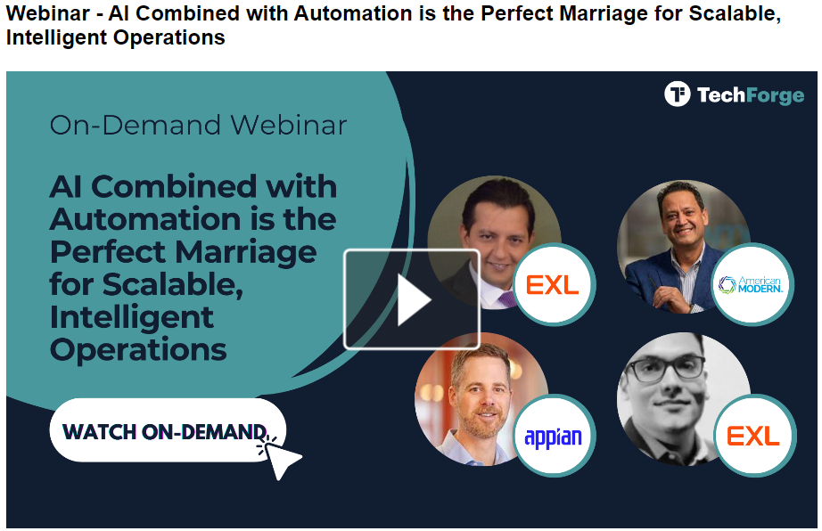
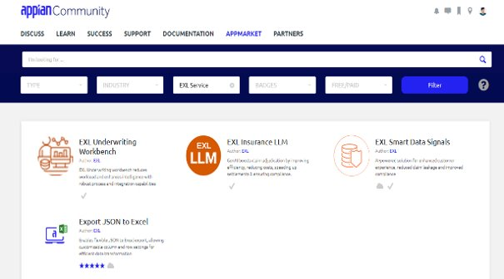

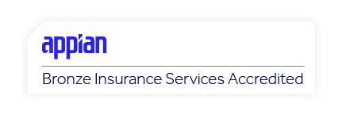
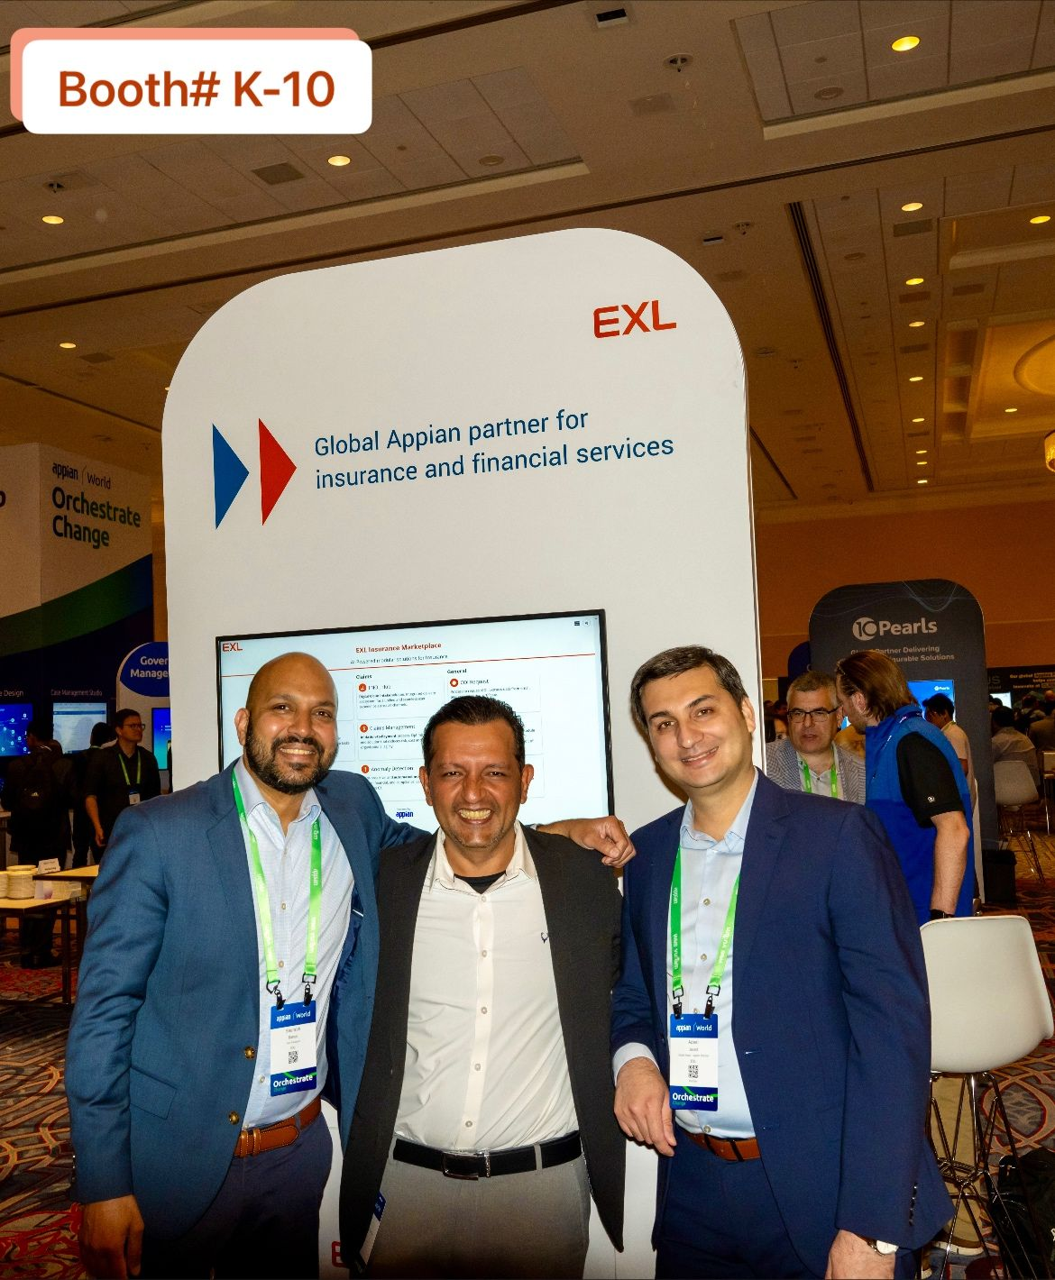
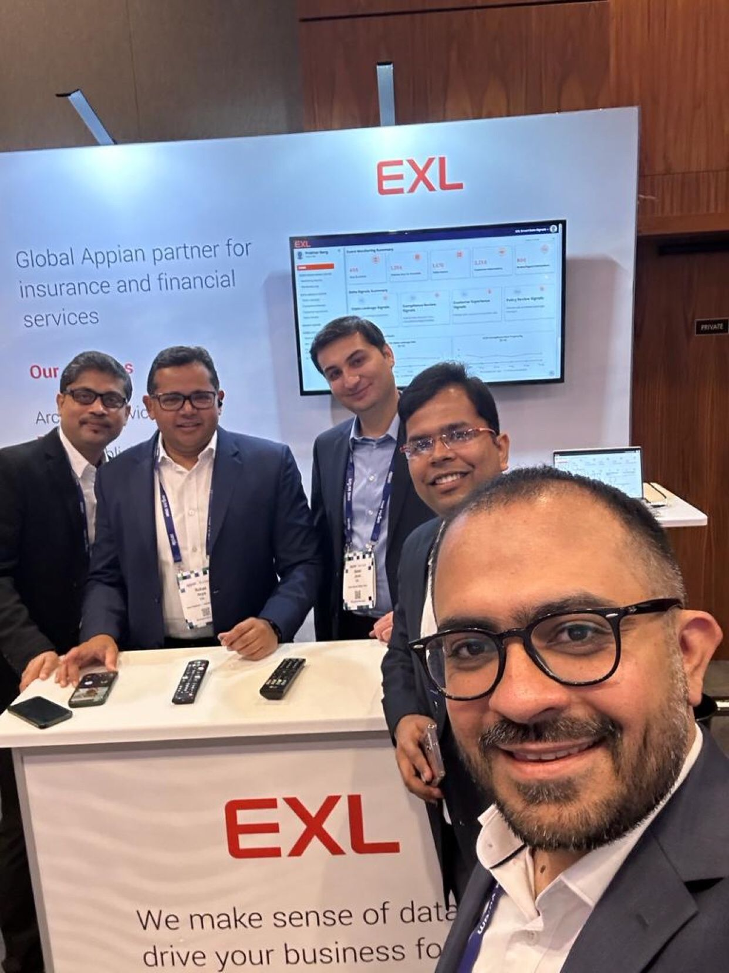
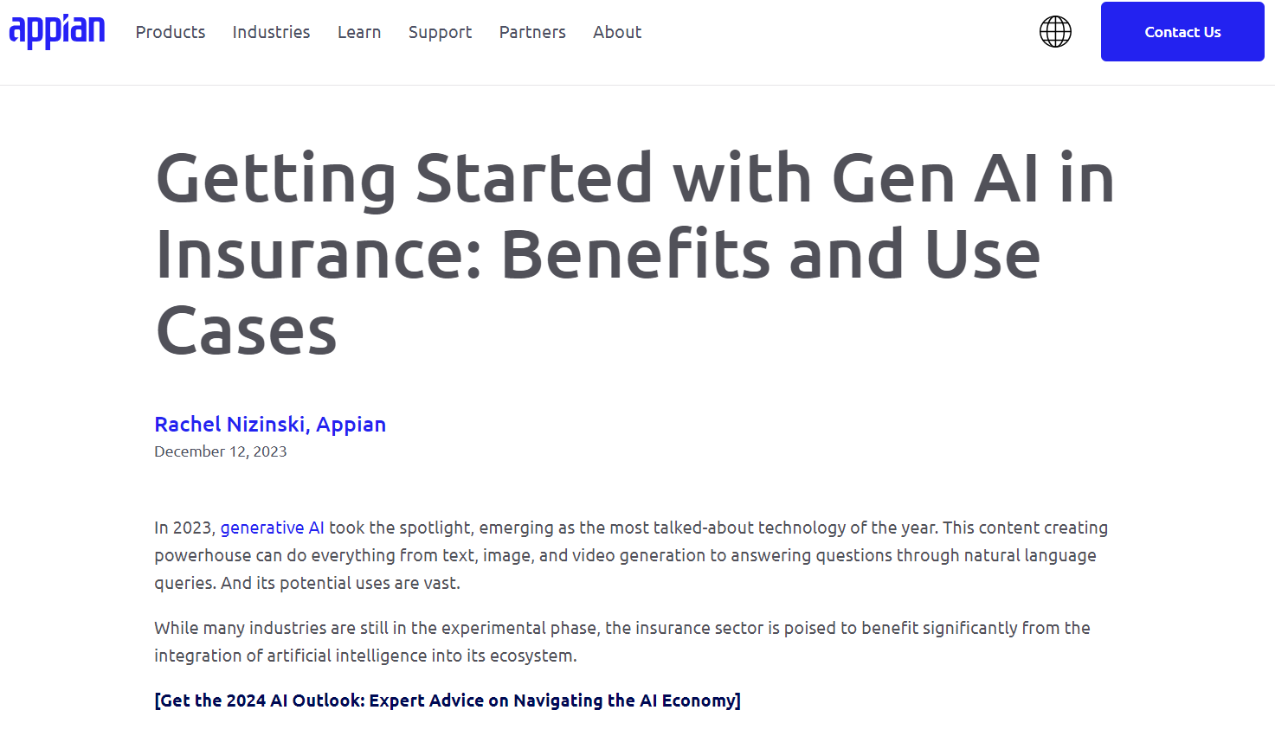
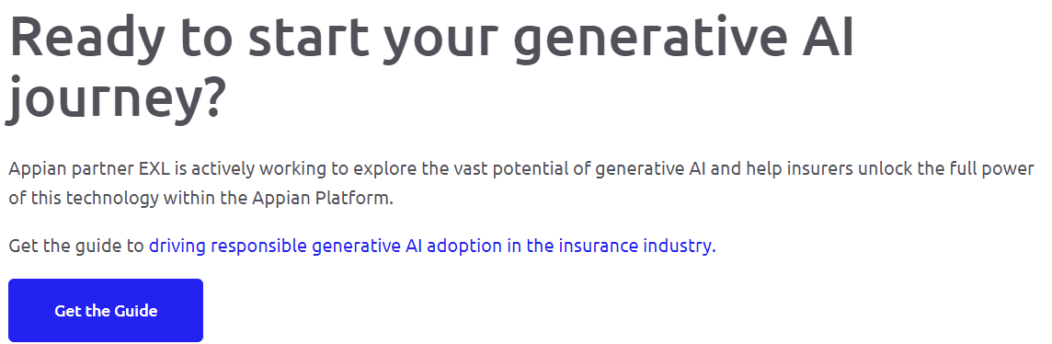
Appian recognizes EXL as a Global Strategic Partner, collaborating closely on key industry and AI-enabled solutions
Our Partnership with Appian
Regular Partnership Connects
Strategic Global Partner: EXL is a strategic Appian partner globally, specializing in the insurance sector. We have dedicated partner managers in the NA, UK&I, and ANZ regions who help us cultivate deeper relationships within Appian.
Leadership Connects: EXL and Appian annually host each other at their respective HQs to review the year and plan for the upcoming one. Leadership on both sides, including CxOs, hold monthly/quarterly meetings to enhance the partnership.
Insurance Accreditation: EXL is currently in the process of obtaining accreditation from Appian for their insurance solutions.
Product Roadmap: The EXL team regularly meets with Appian’s product team to gain insights into the roadmap, ensuring better preparation of the workforce and updating of guidelines.
Appian Engagement: EXL and Appian jointly assess each new engagement to determine the involvement of the Appian Customer Success team.
Staff Pick

Slide 4
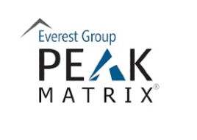

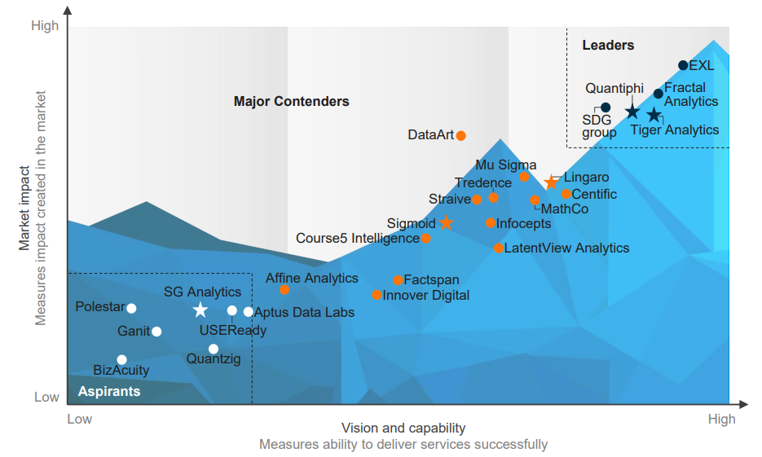


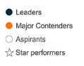

Recognized as a data and AI leader across industries
Everest Group Analytics and Artificial Intelligence (AI) Services Specialists PEAK Matrix® Assessment 2024
Leader Analytics and Artificial Intelligence (AI) Services Specialists PEAK Matrix® Assessment 2024
Market Leader HFS Horizons: AADA Quadfecta Services for the Generative Enterprise 2024
Leader ISG Provider Lens™ Gen AI Services 2024, Global
Strategy and Consulting Services – Mid-Size Providers
Development and Deployment – Mid-Size Providers
Major Player
IDC MarketScape: Worldwide Data Modernization Services 2024
Source: Analytics and Artificial Intelligence (AI) Services Specialists PEAK Matrix® Assessment 2024, Everest Group, 21 March 2024. Licensed for use by EXL.

Slide 5






Trusted Global Appian Partner
Option 1
Our deep domain expertise and extensive experience in managing large scale deliveries, makes us a strategic Appian implementation partner for our clients
250+
Appian Practitioners
Global CoE
with regional presence
99%
Customer Satisfaction Score
Domain Expertise
Banking, Capital Markets, healthcare and Insurance
Leader
Low-code Application Development Services
PEAK Matrix® Assessment 2024 – Focus on Appian
Insurance Services Accredited

Slide 6



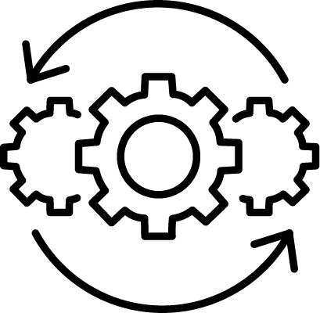
Our Appian Offerings
We support our clients through every phase of their Appian implementation journey
Process Discovery & Transformation
Consulting & Implementation
Industry Solutions & Accelerators
Managed Services & Change Management
Leverage data, AI, and automation to assess, optimize, and redesign business processes.
Design, implement, and deploy end-to-end AI-enabled Appian solutions tailored to your needs.
Deliver results fast with prebuilt AI solutions.
Manage the upkeep of existing Appian apps and infrastructure, ensuring smooth operations and minimal downtime.

Slide 7






Deliver results fast with prebuilt AI solutions
Our Industry solutions
Our suite of Appian + AI solutions, tailored to specific industries and functions, is designed with reusable components that allow for rapid deployment across your enterprise.
Patient Onboarding & Registration
Automate the collection and verification of patient information, insurance details, and consent forms to speed up registration while reducing errors and manual work.
Care Coordination & Case Management
Streamline coordination between doctors, nurses, specialists, and social workers by automating task assignments, communication, and follow-ups — ensuring patients get timely care
9-12 months of additional revenue realized each year
35% more efficient business processes by Year 3
Claims Processing & Insurance Management
Automate claims submission, verification, approvals, and denials workflows to reduce processing time and increase accuracy, improving revenue cycle management..
Financial Risk Lens (Credit Risk / Underwriting)
Credit Memo generation process: an optimized end-to-end solution that ensures transparency, reduces risk, and lowers costs.
Contract Lifecycle
Centralized platform for creation, collaboration, tracking, and compliance of contracts.
Quality Assurance
Proprietary Transaction Monitoring module which helps in setting up of Quality Parameters/Audit Sheets and conducting audit.
Forrester: The Total Economic Impact™ Of EXL's Digital Solutions, December 2022

Slide 8



We differentiate in the Appian ecosystem with deep domain expertise, AI-powered workflows, and effective change management, delivering strategic outcomes for our clients.
Key Differentiators in the Appian Ecosystem
Domain-Specific Workflows & Solutions
Clients undergoing multi-year transformation programs require partners with deep domain knowledge to navigate complex changes and achieve strategic goals. We prioritize delivering tangible outcomes, with a strong emphasis on cost reduction and business model redesign to meet key client expectations.
Real-world AI & GenAI Implementation
Key Differentiators
We are adding patented AI capabilities such as document extraction (Xtrakto.AI™), auto-decisioning, and next best action to enhance workflow efficiency and accuracy. EXL has added GenAI capabilities to all our solutions, and any new custom workflows that are being developed for clients, enhancing efficiency and user experience across the board. For example, UW Assist, or Claims Assist.
Effective Change Management
Our strong operations background and deep integration within client organizations, combined with our extensive domain expertise, provide us with unmatched insights into effective operationalization and change management.

Slide 9
Case Studies & Testimonials

Slide 10
Case Studies
Our success stories in partnering with clients to solve complex business challenges through our Appian offerings
Leading Healthcare Payer
Large UK Specialty Insurer
US Specialty Insurance Leader
Strategic Appian partner to develop enterprise workflows
Post-bind workflow automation powered by Appian and IDP
Managed services CoE to support workflow and RPA based solutions
Design, develop, integrate and implement cloud-based apps for Pre Auth Mgmt. and Claims workflow.
Automate complex business rules within the MRC process to streamline operations, reduce processing time , minimize errors and ensure regulatory compliance.
Successfully took transition of over 70 Insurance processes and 50+ automations. Identified and marked gaps in code, documentation, Application consolidation and optimization opportunity while taking transition.
25%
Process effeciency, through deployment of digital solutions.
50%
Reduction in submission document processing.
$5M
Value delivered through process optimization and deployment of digital solutions
Leading Global Insurance Broker
Leading Global Insurance Broker
Leading US Insurer
Process Discovery & Transformation
Enterprise-wide Workflow CoE leveraging Appian
Claims Vendor Payment Assist using Appian, and IDP
Global Acceleration teams were formed with a focus on Process Simplification, Optimization and assess opportunities to improve the Service Standard Metrics through Quick Wins and Automation.
Build and Deploy Workflow automations at scale – multiple use cases across Geos and LOBs - working in partnership with client’s business, transformation and IT teams.
Appian-based end-to-end workflow to streamline the payment process significantly reducing manual effort.
28%
Improvement in claims settlement TAT.
100+
Appian talent deployed across 15+ global workflow initiatives.
98%
Invoices paid within 7 Days.
Notes:
Quick snapshot of few success stories, and the sort of engagements.
Westcor
Tokio Marine Kiln (TMK)
AMIG
Aon (Acceleration Team)
Aon (Implementation Efforts – multiple policy admins, across geos)
Liberty Mutual

Slide 11

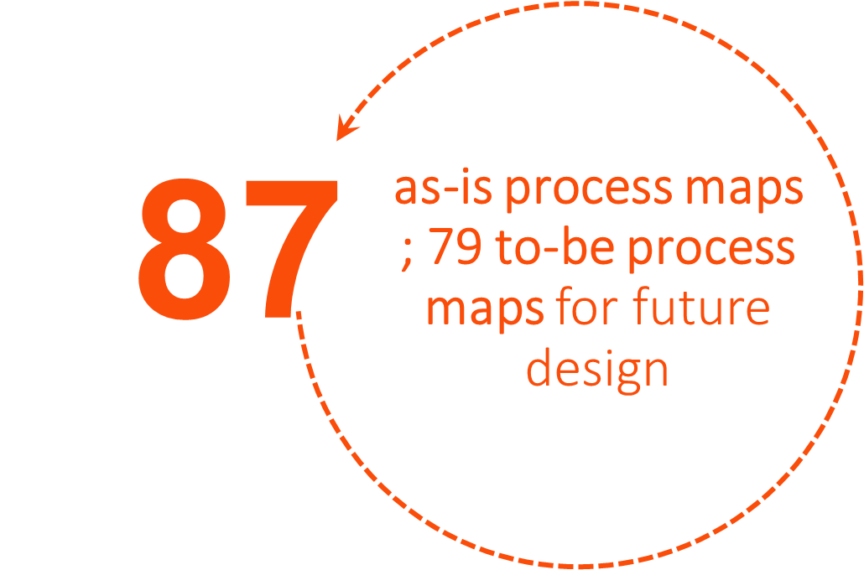
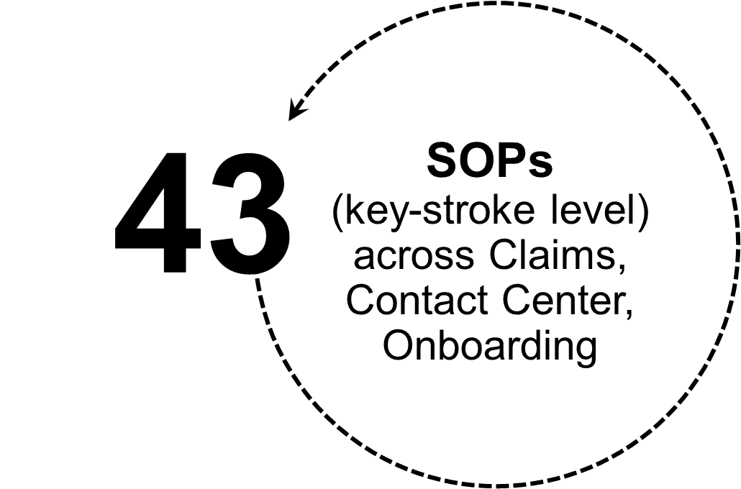
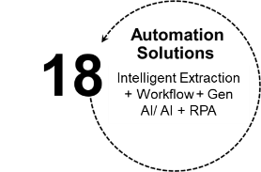
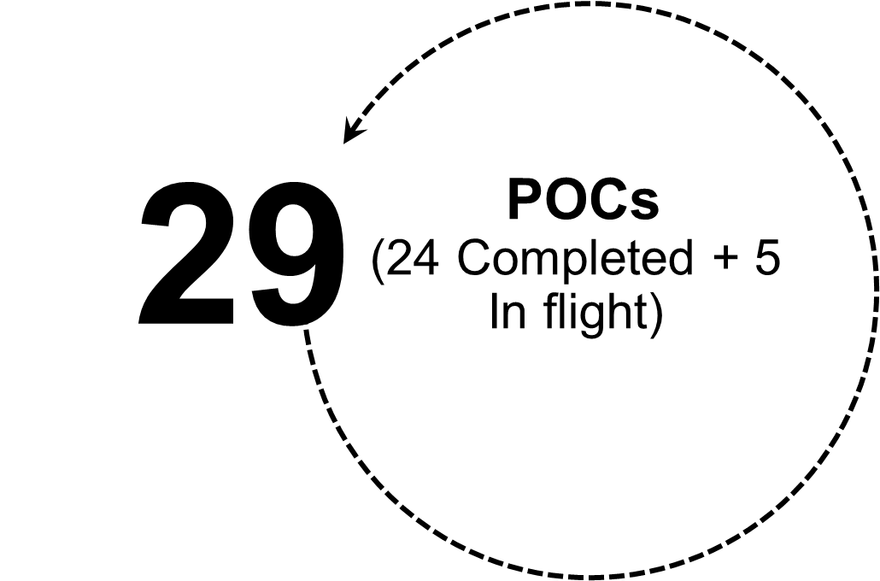
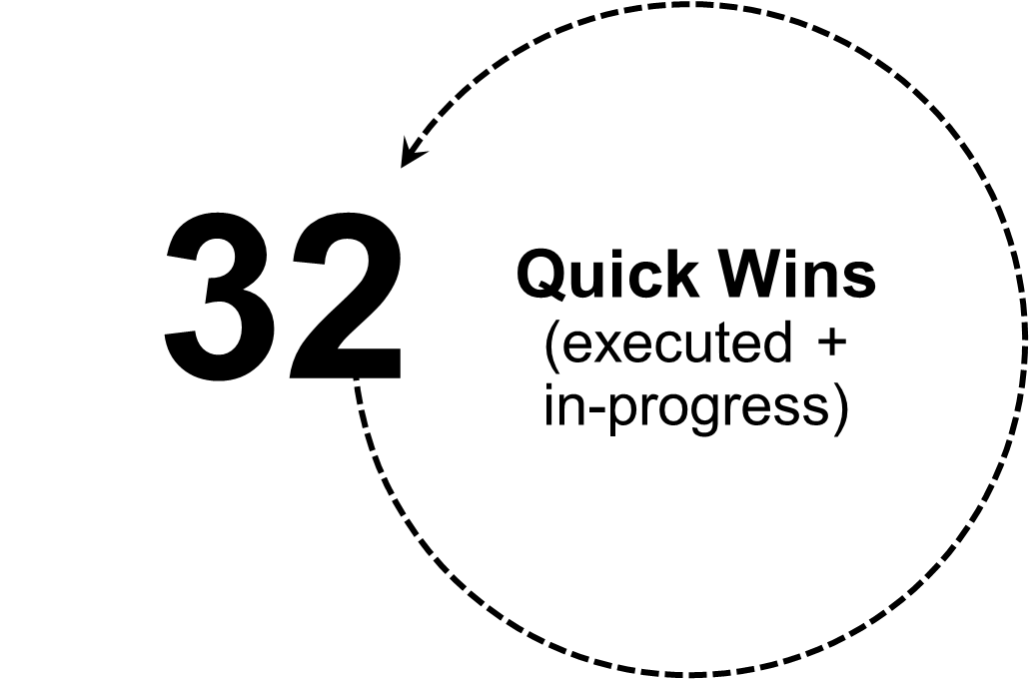
Case Study #1
Our Appian Offerings – Process Discovery & Transformation – Case Study
We set up and delivered a cross-functional, global ‘Acceleration Team’ for a global insurance broking client that quickly identified opportunities across 75 processes
What we Delivered
Business Outcomes
Onboarding & Renewal
5 weeks TAT reduction in New Client Onboarding
3.2k hrs capacity creation for client teams
Need for Acceleration Team
Global Acceleration teams were formed with a focus on Process Simplification, Optimization and assess opportunities to improve the Service Standard Metrics through Quick Wins and Automation.
Invoice & Policy Delivery
9 days Invoicing TAT reduction
54% capacity creation for client teams
15% increment in policy distribution within 30 days
5 Teams
28 Multi-skilled Talent
Claims & Settlements
4 Regions
3K+ FTE coverage
28% claims settlement TAT improvement
2.3K capacity creation for claim handlers
75+ Unique Initiatives Quick Wins and Automation

Slide 12




Case Study #2
Our Appian Offerings - Agile-Led Workflow Implementation – Case Study
Establishing an enterprise-wide Workflow CoE leveraging Appian
EXL Responsibilities
Workflow CoE in numbers
Client
Top Global Broker
Opportunity diagnostics and prioritization
Solution design
Development and implementation
Support and maintenance
100+ Digital talent
50+ Global initiatives
20-70% Efficiency
15-20% Cycle time reduction
Client Challenges
EXL Approach
Lack of structured workflow in operational processes leading to manual intensive activities, no visibility into performance which impacted client’s ability to optimize operations and drive significant cost reduction goals
Siloed transformation initiatives
Limited in-house talent
Lack of scalable and global transformation delivery model
Upstream AI
Process redesign by code
Cloud scale
Elevated human
EXL Solution for Workflow CoE
Date ingestion from unstructured inputs
Processes orchestrated on low-code workflows
Digital and RPA solutions in Cloud
Monitoring and AI enablement
People: Supporting global initiatives with scalable delivery and best in class talent
Processes / Frameworks: Proprietary toolkits to reduce delivery risks and ensure benefit delivery
Technology: Pre-built solutions and accelerators to improve speed to value
Select Workflow solutions deployed (Total 15+ workflows across Pre-bind and Post-bind value chain)
Solution description | Impact
Digital Workflow for the Policy Issuance which orchestrates all required activities and documentation to issue policies, renewals and endorsements integrated with CRM and documentation solution | 12-15% Efficiency Gain 5-8% Quality Improvement 3-7% reduction in cycle time
Digital Workflow for Client Account Management teams to have better visibility, control and improved efficiency of the Investment Consulting operations including Client Calendar Management, Investment Policy Statements, Asset Allocation Study, Manager Selection, Performance Reports, Special Projects | 30% Efficiency Gain 15-20% Quality Improvement
Digital Workflow for issuance of insurance policy for bonds consisting of:- Application creation, Insurance policy issuance, Payments, Billing, Collections and Cancellations. The solution is integrated with Outlook, SharePoint, and Insurance Portals | 10-15% Efficiency Gain 15% Quality Improvement 15% reduction in cycle time
Appian Components
EXL Engagement
Build and Deploy Workflow automations at scale – multiple use cases across Geos and LOBs - working in partnership with client’s business, transformation and IT teams
Data Fabric
API Integration
IDP
Workflow

Slide 13
Select Workflow Implementations
Enterprise Appian Implementation and Maintenance | Case Study 1 – Leading Global Broker
Project Name | Description | Benefits delivered
Underwriting Submissions | End to end management of new business and renewal submissions incorporating intelligent content extraction, business rule management, data validation and enrichment | 35% efficiency improvement Improved compliance for better UW decisions
Commercial Property Risk - Quote and Servicing | End to end servicing platform to handle quoting, customer onboarding, mid-term adjustments, policy renewals and premium changes | ~25% efficiency, Improved Client Satisfaction, Higher New business, lower E&Os
Remittance | Digital Remittance application to handle payment received from field agents including check scanning, bank statement validation, payment application and suspense amount resolution | 25-30% Efficiency Gain 15-20% reduction in Cycle Time 2-3% improvement in process quality
Claims | Digital Claims application to handle end to end claim lifecycle from loss report (FNOL) to Payment. Includes email ingestion, document extraction, payment | 15-2% reduction in FNOL cycle time 35-40% Efficiency Gain for paper FNOL 2-3% improvement in process quality
Health Solutions | Digital solution to integrate small vertical teams into “One National Team”. One stop solution for management reports to enhance agility | TAT improvement by ~15%​ Accuracy improvement by ~20% Support operating model redesign to standardise work​
New Client Onboarding | Digital workflow for end-to-end management of new client onboarding lifecycle | ~40% reduction in onboarding time, improved CSAT, faster revenue realisation
Intercompany Accounting | Digital Workflow to handle intercompany accounting transactions across the Globe to ensure timely cash allocation and closure of accounts | 80% reduction in out of balance accounts Improved SOX Compliance
Digital Policy Management | Digital workflow solution to manage end to end policy issuance lifecycle which standardises and enables management of all required activities and documentation | Replacement of an obsolete solution with a modern solution including new functionalities and features
User Dashboard | Digital workflow solution to standardise Revenue Recognition process resulting in elimination of manual work assignments, improved productivity and ensure that all aspects of process are completed in a timely manner with proper tracking | Supports revenue recognition of >$100M USD of revenue 5-7% Improved Data Quality/Accuracy
Document management | Digital workflow covering a range of policy placement activities starting with client and carrier onboarding, policy creation and amendments, through the invoicing process | $1.10 M cost avoidance ~14K annual hours of efficiency saving

Slide 14
Select client testimonials from Appian implementations
Enterprise Appian Implementation and Maintenance | Case Study 1 – Leading Global Broker
“Thanks a lot for your leadership and commitment, it is a big achievement for our region, and I hope that this could also be a good example and solution globally. Congratulations to the entire Project Team! It is a first step but deserves celebration and recognition.” – Regional COO
“Great work! No doubt that all of this is due to a great teamwork with high commitment to achieve results, discipline for several months and resilience in all moments. Most of all, due to a great capacity of leadership to concatenate all parts, plan and solve problems during the journey.” – Regional Director (Ops)
"I appreciate everything the team has done and look forward to expand the use of this tool across regions and solution lines“ – Global Change and Transition Leader
"CONGRATULATIONS!! on reaching this very important milestone. This project is an excellent testament of our ability to partner across business, change, technology and platforms to deliver fantastic results for the firm“ - Director, Project Management Office
"As we finish the project, I want to share some wrap-up thoughts with the team. It has been a long journey we had together irrespective of all the ups and downs. Beyond the complex planning and multi-national, multidisciplinary approach, teams, and technologies, my thoughts are with the women and men who gave what they had to reach to the point where we are today. I just want to say THANK YOU for the late nights and weekends you took out, or cracked your brains for that elusive code lines when you were exhausted. I wish you the best for all your future professional and personal endeavors. Cheers“ – Unit Director

Slide 15


Case Study #3
Our Appian Offerings - Agile-Led Workflow Implementation – Case Study
Appian based Client Onboarding Workflow solution
Client
EXL Solution
Outcomes
Top Global Broker
Integration of 12 disconnected systems
Creation of standardized Global Onboarding Process
Removal of data integrity issues and discrepancies
5300+Hours of annual workhours savings
5 Weeks Reduction in overall turn around time for onboarding new clients
Standardization Of process and activities across regions and markets
Client Challenges
12 disconnected systems contributing towards data discrepancy, data accuracy and standardization
Data quality issues in systems leading to high effort and turnaround time
Disparate data sources and siloed tracking methods
Delay in revenue recognition and poor customer satisfaction due to higher onboarding timelines
EXL implemented the Client Onboarding Workflow solution leveraging Appian platform to reduce time and effort via automated task creation through integration with CRM system and automated downstream processing for systems such as Policy Admin, Finance and Planning.
The solution was equipped with standardized templates and onboarding resources/materials to ensure process standardization. The workflow was designed to support scalability and all the functionalities created as part of the solution can be leveraged in other geographies as well.
Workflow provides activity tracking, ensures consistency, and enables task automation for compliance, onboarding and implementation activities resulting in no manual handoffs and automatic notifications to meet SLAs.
System integration with multiple downstream systems with APIs and SFTP.
Appian Components
Data Fabric
API Integration
RPA
EXL Engagement
Client VOC
Reduced client onboarding TAT from 84 to 28 days by integrating downstream systems for data accuracy and consolidating processes into a unified global workflow.
“Congratulations on reaching this very important milestone. This project is an excellent testament of our ability to partner across business, change, technology and platforms to deliver fantastic results for the firm.“
Vice President, Global Transformation and Change
IDP
Workflow

Slide 16




Case Study #4
Our Appian Offerings - Agile-Led Workflow Implementation – Case Study
Claims Payment Assist – Invoice Validation and Automation powered by Appian and IDP
Client
Engagement Objective
Outcomes
1
2
.
Leading Insurer
Automated invoice ingestion using Mailbox integration, AI-driven extraction, validation against business rules, automated insights generation
98.5% -Invoices Paid within 7 Days
$232K - Savings within first 5 months
4.5% - Total Savings %
63% - No Touch Review and Payments
Appian-based end-to-end workflow to streamline the payment process significantly reducing manual effort
Client Challenges
ALAE and Indemnity Payments for 200+ suppliers are reviewed and processed manually by Claim handlers
Complex vendor contracts impacted claim handlers' ability to validate invoice amounts with contracted rates, resulting in cost leakages
Inadequate application of discounts, example, quick pay discount, volume discount etc.
Lack of systemic controls to flag duplicate invoices
Manual approval process and reporting/insights generation process
Inefficiencies in process leading to penalties, higher costs, strained supplier relationships, and
3
4
.
Comprehensive database management with automated validations to minimize payment errors
Ability to manage the contractual rates, payment limits and exceptions based on access and complexity levels
Appian Components
EXL Engagement
Phase 1 Expense Payments for Contracted Suppliers
Created a Datamart repository for all contractual rates, clauses and validation rules
Automated validation of ALAE charges and payment processing through API integration
Enabled real-time reporting through an all-inclusive Power BI Dashboard
Phase 2 Repair Payments and Payments for non-contracted suppliers
AI-driven extraction from pdf invoices to automate loss payments
Comparison with estimates to validate invoice amount
Automated the manual process of approving the payments based on authority limits
Data Fabric
API Integration
Insights
IDP
Workflow
Business Rules

Slide 17
Case Study #5
Our Appian Offerings - Industry Solutions & Accelerators – Case Study
Strategic transformation partner to develop Appian-based enterprise workflows
Client
Engagement Objectives
Outcomes
1
2
20%+ OPEX Reduction
Through Digital Applications
30-70% Cycle Time Reduction
Highly automated and dynamic workflows
3 Months
Transition timeline to fully consolidate 300+ FTE operation
Leading Land Title Insurer
Design, Develop, Integrate and Implement cloud-based apps for Agency Mgmt., Remittance and Claims
Consolidate Title services and Insurance operation from multiple partners into EXL’s offshore model
Strategic Objectives
Build highly scalable operating model to cope with cyclical nature of title business
Explore new revenue streams
Become an innovation leader in the title space and enhance market share
EXL Engagement
Cloud receiving centre
Offshoring of Title, Agency and Remittance operations
Process optimization
Legacy system replacement
Reimagined workflows leveraging AI and cloud
AI CoE
New claims and agency billing systems with AI, ML, Cloud native and analytics led solutions using Appian low code / no code platform
Appian Components
Key Challenges
EXL Solutions
Data Fabric
API Integration
Insights
Legacy application footprint, unable to support aggressive growth plans
Manual and Paper intensive processes
Traditional Human:OS – more resources required to handle volume surge
Claims
Online Claim portal for Agents and Customers
IDP: AI based content extraction from claim documents
Appian based workflows for intake and processing
Integrated communication solution
Remittance
IDP: AI based content extraction from checks
Appian based workflows for intake and processing
Rating calculator encompassing 50+ states and complex business rules
Title operations
Automation of customer billing process
IDP: AI based content extraction for automated Title Search and Title closing process leveraging RPA
B2B Customer portal for billing reports and reconciliation
IDP
Workflow
Client VOC
“EXL is not a vendor, EXL is a high-tech digital partner. EXL understands we are trying to build a new process and suggests where we can leverage AI, Automation to reimagine the business and build a truly digital native cloud-based platform.” - CEO

Slide 18
Our Appian Offerings - Industry Solutions & Accelerators – Case Study
Case Study #6
Post-bind workflow automation powered by Appian and IDP
Client
Engagement Objective
Outcomes
Leading Insurer
Automate complex business rules within the MRC process to streamline operations, reduce processing time , minimize errors and ensure regulatory compliance.
Automated the MRC document processing workflow, reducing processing time by 50%.
5-10 percent reduction in data errors, leading to more accurate claims settlement
Reduced operational costs by 30% due to decreased manual labor and faster processing times.
Ensured adherence to Underwriting guidance with automated checks and data validations
Faster and more accurate processing led to improved customer satisfaction.
Client Challenges
Manual Processing: The existing MRC document processing workflow was manual and labor-intensive
Time-Consuming: Processing documents took a significant amount of time, leading to delays in policy issuance.
Error-Prone: Manual handling and data entry were prone to errors, affecting the accuracy of the processed documents.
High Operational Costs: The manual workflow resulted in increased operational costs due to the need for extensive labor.
Customer Dissatisfaction: Delays and inaccuracies in document processing led to lower customer satisfaction and retention.
EXL Engagement
To address the client's challenges, we implemented IDP solution integrated with Appian's powerful workflow automation capabilities. Our engagement included:
Conducted a thorough assessment of the client's existing MRC document processing workflow to identify pain points and areas for improvement.
Designed a comprehensive solution leveraging IDP and Appian's workflow automation platform.
Deployed the MRC application, ensuring seamless integration with the client's existing systems and processes.
Provided training to the client's staff on using the new system and offered ongoing support to ensure smooth operation.
Appian Components
Data Fabric
API Integration
Insights
IDP
Workflow

Slide 19




Case Study #7
Our Appian Offerings - Managed Services – Case Study
Managed services CoE to support workflow and RPA based solutions
Client
Engagement Objectives
Outcomes
Leading Insurer
The insurer had requirement to completely own digital function by:
Understanding business problems and ask
Identify automation opportunities
Develop automation pipeline and prioritize with business
Propose solutions for new opportunities & existing automations
Prioritize automation related solutions
Own production run, enhancements/bugs
End to end project management
50% less dependency on Client SMEs
70% more stable production
40% improved resolution turnaround time
Client Challenges
Technology Stack
Existing applications were owned by incumbent vendor who did not maintain any documentation
Unstable code/implementation. All automations required manual trigger (human intervention)
Almost no exception handling leading to fragile Production
Complex IT processes. Requires approval from IT owners for every small change.
Client IT lacks documentation & understanding of processes
EXL Engagement
Data Fabric
API Integration
Transition: Successfully took transition of over 70 Insurance processes and 50+ automations. Identified and marked gaps in code, documentation, Application consolidation and optimization opportunity while taking transition
Feature teams: Feature teams formed and deployed for each business functions to support and develop applications across multiple automation lever like RPA, Workflow, Power BI and Python
Documentation: Developed Process documents & production manual while taking transition
Project Management: Configured DevOps for better tracking and end to end project management
Digital Framework: Deployed best practices for better documentation, and streamlining end to end project delivery
Production Stabilization: Analysis of existing processes to optimize production run and identify gaps in production code. Configured and enabled Audit logs, enhanced exception handling for better issue resolution.
RPA
Workflow
Insights
Client VOC
“Our Team was eloquent to suggest that they were thrilled and elated to work with EXL Automation team, and that they were pleasantly surprised about the pace at which the automations are delivered by EXL when compared to Major Organizations of the Industry”

Slide 20
Talent Profiles

Slide 21
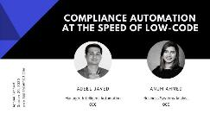
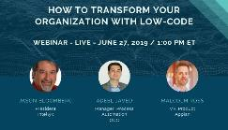
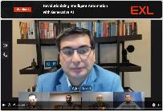

Adeel Javed – Appian Architect & Practice Lead
Resourcing & Commercials - Key Profiles
2 decades of experience, helping companies across industries, automate their processes. Well-versed in process automation technologies, such as, BPM, RPA, IDP, Agentic AI and integrations. Extensive experience developing teams from the ground up, setting up the center of expertise (CoE), and defining end-to-end delivery methodologies.
Engagements and Assignments
Leading the Appian delivery team at EXL. Responsible for providing design and architecture guidance on all clients.
Led the process automation practice at a US financial services company. Built the team from the ground up, and setup the center of expertise. Delivered automations that increased the compliance posture, reduced risk, and returned valuable hours back to the business.
Led the effort to automate the corporate trust onboarding process at a large US bank, with the goal of improving customer experience. Responsible for the technical architecture and delivery.
Managed multiple process automation initiatives at a Fortune 500 manufacturing company with the goal of reducing cycle times. Assisted in setting up the center of excellence to increase adoption across the company.
Assisted a large US financial services company in redesigning their reconciliation process to improve resource utilization. Responsible for understanding and documenting current state and identifying potential digital innovation opportunities within their reconciliation process.
Assisted a large US bank in redesigning their fraud claim process to reduce cycle time. Responsible for understanding the current state pain points and identifying improvement opportunities.
Assisted a large Fortune 500 manufacturing company in redesigning their returns and repair process to reduce cycle time. Responsible for understanding the current state pain points and identifying improvement opportunities.
Thought Leadership
Revolutionizing Intelligent Automation with Generative AI (Webinar)
Robotic Process Automation using UiPath StudioX: A Citizen Developer’s Guide to Hyperautomation (Book)
Applications at the Speed of Low-Code (Appian Blog)
Low Code: How to Build an App a Day (Appian Blog)
Skip navigation Search Sign in Appian World 2018: OCC - Transforming Risk Controls at a SIFMU (Appian World)

Slide 22
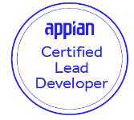
Sanjay Joshi - Appian Architect
Resourcing & Commercials - Key Profiles
Technical Architect with 13+ years of experience across multiple domains. Over 8 years of experience in delivering projects using BPM (Appian), RPA.
Engagements and Assignments
Over 13+ years of diverse experience in architecture, design, development, implementation and support-activities
Adept in Appian BPM solution design, application development and consulting Business Process Automation and Robotics Process Automation
Exposure to implementation of Appian feature like Integration, process modelling, SAIL, RPA, records, reports.
Demonstrated mastery in evaluating requirements for business application integration and process automation
Proven mentor and training with expertise in communicating across organizational levels with cross functional teams
Developed a Business Solution using Appian, which is listed on the Appian App Marketplace
Created Design standards, guidelines, best practices w.r.t requirements as well as performance metrics.
Skilled in extensive Agile application development : Scrum and Kanban Framework.
Rich domain experience - Insurance, Banking.
Key Skills and Industry Expertise
Academic Credentials
Workflow: Appian
RPA: Blue Prism
ETL: Informatica
Database: MS SQL, My SQL, Maria DB, Teradata
Languages: COBOL, HTML
ALM Tools: JIRA, ADO, Confluence, Asana
Project Methodology: Agile, Scrum
B.Tech. in Computer Science & Engineering
Appian Lead Developer Certified
Blue Prism RPA Certified
Certified Scrum Master

Slide 23
Prakhar Garg - Appian Architect
Resourcing & Commercials - Key Profiles
Technical Architect with 10+ years of experience across multiple domains. Over 10 years of experience in delivering projects using BPM (Appian), RPA.
Engagements and Assignments
Over 10+ years of diverse experience in architecture, design, development, implementation, and support activities
Active involvement in various stages of SDLC and Agile Methodologies, including Appian Training, Recruitment, Requirement Analysis, Design, Estimation, Development, Implementation, Solution Designing, RFPs, and Maintenance.
Designed a solution and led a team of 7 developers to deliver Stock Plan Services automation for a leading financial institution in the UK. There were zero Go-Live/Post Go-Live issues.
Instrumental in setting up the COE and designed solutions for Investment Process Automation for another leading financial institution in the UK, reducing the turnaround time from 2 weeks to approximately 4 days.
Hands-on experience in Test Automation suite design and development using Selenium and Fitness, which eliminated manual regression tests after every deployment.
Hands-on experience in Plugin development for extending features within the workflow and setting up the Appian On-Premise environment.
Prominent in smoothening the Procurement Process for a healthcare leader in the US.
Exposure to implementation of various Appian features like Integration, process modelling, SAIL, RPA, records, and reports.
Proven mentorship and training experience, with expertise in communicating across organizational levels with cross-functional teams.
Created Design standards, guidelines, best practices with respect to requirements as well as performance metrics.
Rich domain experience in Financial, Insurance and Banking.
Key Skills and Industry Expertise
Academic Credentials
Workflow: Appian, OutSystems
RPA: Blue Prism, Appian RPA
ETL: Informatica
Database: My SQL, Maria DB, Oracle 11, SQL Server
Languages: HTML, Java
ALM Tools: JIRA, Confluence, Asana
Project Methodology: Agile, Scrum
B.Tech. in Computer Science & Engineering
Appian Lead Developer Certified
Programming in HTML5 Certified

Slide 24

Deepanshu Kumar – Technical Lead
Resourcing & Commercials - Key Profiles
With over 7+ years of IT experience, I specialize in the full application lifecycle—from design and development to implementation and ongoing support. My expertise includes gathering comprehensive requirements, creating business documentation, and driving initial design phases through client approvals.
Engagements and Assignments
Over 7+ years of experience in IT, specializing in the design, development, implementation, and support of various applications.
End-to-end requirements gathering & preparing business requirements document , initial design to get the client sign-off.
Designing and implementing advanced workflows and Business Process Management (BPM) solutions.​
Participating actively in Agile methodologies, including sprint planning and retrospective sessions.
Creating technical design documents and formulating solution architectures that align with business needs.
Developing scalable, high-performance code with a focus on maintainability and efficiency.
Writing and deploying serverless functions to handle various backend tasks.
Conducted peer reviews to ensure code quality, maintainability, and alignment with project standards.
Worked collaboratively with cross-functional teams, including QA, operations, and business analysts, to ensure successful implementation and delivery of projects.
Providing ongoing support after deployment, including troubleshooting, debugging, and refining applications to meet evolving business needs and ensure long-term success.
Implementing security measures in the development process, ensuring applications are protected against potential vulnerabilities and compliant with industry standards.
Key Skills and Industry Expertise
Academic Credentials
Technology: BPM, RPA, Database, Rest APIs
Agile Methodology: JIRA, Confluence, Scrum, Asana
Tools: Appian, SQL, MS VISO
Domain: Insurance, Banking and Financial Services and Automobile
2023: Appian Senior Developer Certification
Appian Associate Developer Certification
Appian Analyst, Appian Designer Certification
B.Tech in Computer Science & Engineering

Slide 25
Lokesh – Technical Lead
Resourcing & Commercials - Key Profiles
5+ years of experience in IT and 3.5 years of experience in Appian BPM 19.x to 24.1.x. Familiar with all aspects of technology projects with Business Requirements, Development, Deployment and support.
Engagements and Assignments
Over 5+ years of experience in IT, specializing in the design, development, implementation, and support of various applications.
Designing and developing complex workflows and business process management (BPM) solutions.
Implementing Appian applications to streamline business processes and improve operational efficiency.
Providing ongoing support and maintenance for Appian applications, ensuring optimal performance and user satisfaction
Developing server-side applications and RESTful APIs.
Writing and maintaining code for scalable and high-performance applications.
Writing and deploying serverless functions to handle various backend tasks.
Integrating Lambda functions with other AWS services for seamless application functionality.
Key Skills and Industry Expertise
Academic Credentials
Workflow: Appian
Technologies: Java, Node JS, Typescript, AWS
Testing Framework: Jest, Mocha and Chai
Database: My SQL
ALM Tools: JIRA, ADO.
Project Methodology: Agile, Scrum
B.Tech. in Electrical & Electronics Engineering
Appian Senior Developer Certified
AWS Cloud Practitioner

Slide 26

Adeel Javed – Chief Appian Architect & Practice Lead
2 decades of experience, helping companies across industries, automate their processes. Well-versed in process automation technologies, such as, business process management (BPM), robotic process automation (RPA), intelligent document processing (IDP), and integrations. Extensive experience developing teams from the ground up, setting up the center of expertise (CoE), and defining end-to-end delivery methodologies.
Engagements and Assignments
Leading the Appian delivery team at EXL. Responsible for providing design and architecture guidance on all clients.
Led the process automation practice at a US financial services company. Built the team from the ground up, and setup the center of expertise. Delivered automations that increased the compliance posture, reduced risk, and returned valuable hours back to the business.
Led the effort to automate the corporate trust onboarding process at a large US bank, with the goal of improving customer experience. Responsible for the technical architecture and delivery.
Managed multiple process automation initiatives at a Fortune 500 manufacturing company with the goal of reducing cycle times. Assisted in setting up the center of excellence to increase adoption across the company.
Assisted a large US financial services company in redesigning their reconciliation process to improve resource utilization. Responsible for understanding and documenting current state and identifying potential digital innovation opportunities within their reconciliation process.
Assisted a large US bank in redesigning their fraud claim process to reduce cycle time. Responsible for understanding the current state pain points and identifying improvement opportunities.
Assisted a large Fortune 500 manufacturing company in redesigning their returns and repair process to reduce cycle time. Responsible for understanding the current state pain points and identifying improvement opportunities.
Key Skills and Industry Expertise
Academic Credentials
BPM: Appian BPM, IBM BPM
RPA: Blue Prism, UiPath StudioX
Integrations: Oracle Fusion Middleware, webMethods IS, Web Services, REST
Industry: Insurance, Banking & Capital Markets, Manufacturing
MS Computer Sciences
Appian Certified
Blue Prism Certified
UiPath Certified
Celonis Certified
PMP Certified

Slide 27

Sanjay Joshi - Appian Architect
Technical Architect with 13+ years of experience across multiple domains. Over 8 years of experience in delivering projects using BPM (Appian), RPA.
Engagements and Assignments
Over 13+ years of diverse experience in architecture, design, development, implementation and support-activities
Adept in Appian BPM solution design, application development and consulting Business Process Automation and Robotics Process Automation
Exposure to implementation of Appian feature like Integration, process modelling, SAIL, RPA, records, reports.
Demonstrated mastery in evaluating requirements for business application integration and process automation
Proven mentor and training with expertise in communicating across organizational levels with cross functional teams
Developed a Business Solution using Appian, which is listed on the Appian App Marketplace
Created Design standards, guidelines, best practices w.r.t requirements as well as performance metrics.
Skilled in extensive Agile application development : Scrum and Kanban Framework.
Rich domain experience - Insurance, Banking.
Key Skills and Industry Expertise
Academic Credentials
Workflow: Appian
RPA: Blue Prism
ETL: Informatica
Database: MS SQL, My SQL, Maria DB, Teradata
Languages: COBOL, HTML
ALM Tools: JIRA, ADO, Confluence, Asana
Project Methodology: Agile, Scrum
B.Tech. in Computer Science & Engineering
Appian Lead Developer Certified
Blue Prism RPA Certified
Certified Scrum Master

Slide 28

Prakhar Garg - Appian Architect
Technical Architect with 10+ years of experience across multiple domains. Over 10 years of experience in delivering projects using BPM (Appian), RPA.
Engagements and Assignments
Over 10+ years of diverse experience in architecture, design, development, implementation, and support activities
Active involvement in various stages of SDLC and Agile Methodologies, including Appian Training, Recruitment, Requirement Analysis, Design, Estimation, Development, Implementation, Solution Designing, RFPs, and Maintenance.
Designed a solution and led a team of 7 developers to deliver Stock Plan Services automation for a leading financial institution in the UK. There were zero Go-Live/Post Go-Live issues.
Instrumental in setting up the COE and designed solutions for Investment Process Automation for another leading financial institution in the UK, reducing the turnaround time from 2 weeks to approximately 4 days.
Hands-on experience in Test Automation suite design and development using Selenium and Fitnesse, which eliminated manual regression tests after every deployment.
Hands-on experience in Plugin development for extending features within the workflow and setting up the Appian On-Premise environment.
Prominent in smoothening the Procurement Process for a healthcare leader in the US.
Exposure to implementation of various Appian features like Integration, process modeling, SAIL, RPA, records, and reports.
Proven mentorship and training experience, with expertise in communicating across organizational levels with cross-functional teams.
Created Design standards, guidelines, best practices with respect to requirements as well as performance metrics.
Rich domain experience in Financial, Insurance and Banking.
Key Skills and Industry Expertise
Academic Credentials
Workflow: Appian, OutSystems
RPA: Blue Prism, Appian RPA
ETL: Informatica
Database: My SQL, Maria DB, Oracle 11, SQL Server
Languages: HTML, Java
ALM Tools: JIRA, Confluence, Asana
Project Methodology: Agile, Scrum
B.Tech. in Computer Science & Engineering
Appian BPM Certified
Programming in HTML5 Certified

Slide 29

Sri Charan Bonagiri - Appian Architect
Technical Architect with 13+ years of experience across multiple domains. Over 8 years of experience in delivering projects using BPM (Appian).
Engagements and Assignments
Over 13+ years of diverse experience in architecture, design, development, implementation and support-activities
Active involvement in Appian Training, Recruitment, Requirement Analysis, Design, Estimation, Development, Implementation, Solution Designing, RFPs and Maintenance phases of SDLC and Agile Methodologies
Exposure to implementation of Appian feature like Integration, process modelling, SAIL, RPA, records, reports.
Demonstrated mastery in evaluating requirements for business application integration and process automation
Proven mentor and training with expertise in communicating across organizational levels with cross-functional teams.
Created Design standards, guidelines, best practices w.r.t requirements as well as performance metrics.
Experience in migration of Appian on-premise environment.
Skilled in extensive Agile application development : Scrum and Kanban Framework.
Rich domain experience - Insurance, Banking.
Key Skills and Industry Expertise
Academic Credentials
Workflow: Appian
Database: MS SQL, My SQL, Maria DB
Languages: Java, HTML
ALM Tools: JIRA, Confluence
Project Methodology: Agile, Scrum, Scaled Agile
M.Sc. in Project Management
Appian BPM Certified

Slide 30

Sanketh Vidap - Appian Technical Lead
Technical Lead with 15+ years of experience for clients across BFSI domains.
Engagements and Assignments
Over 15 years of diverse experience in Application development, Production support and Project management
Actively Involved in Appian Training, Recruitment, Requirement Analysis, Design, Estimation, Development, Implementation, Solution Designing, RFPs and Maintenance phases of SDLC and Agile Methodologies
Was instrumental in setting up COE and successfully implementing Cross-Talk concept including creating Town Plan architecture in ODC (Team of 100) across multiple portfolios enriching the ODC’s Functional knowledge of Claim processing management
Expertise in implementation of Appian features like SAIL, CDT creation, Reports, Dashboards, Tempo and Records – Got 6 times Customer Kudos for the Quality of Projects Delivered and received STAR Team Award among 24 teams
Played roles of Process Champion and Configuration Manager – played instrumental role in improving the SLA Response and Resolution and maintained it 100% for consecutively 13 months, Best Practice accepted in Internal Quality Audit at Project level
Experience in migration of Appian on-premise environment along with Stress Testing using JMeter
Rich domain experience across Enterprise Data Management – Reference data, Client On boarding, KYC, Insurance –Claims processing, Financial – Asset Management, Invoice Management
Key Skills and Industry Expertise
Academic Credentials
Workflow: Appian
Database: MS SQL Server, MySQL, MariaDB
Tools: JMeter (Stress Testing)
Industry: Investment Banking, Insurance
B.E – Electrical and Electronics Engineering (MIT, Manipal)
Appian BPM Certified

Slide 31
First, Last Name
exlservice.com
Title
Global headquarters
emailaddress@exlservice.com
O: +1(000) 000-0000 M: +1(000) 000-0000
320 Park Ave, 29th floor New York, NY 10022
T: +1(212) 277-7100 F: +1(212) 277-7111
First, Last Name
United States | United Kingdom | Australia Bulgaria | Colombia | Czech Republic India | Ireland | Philippines | Mexico Romania | South Africa
Title
emailaddress@exlservice.com
O: +1(000) 000-0000 M: +1(000) 000-0000
© 2024 ExlService Holdings, Inc. All rights reserved. For more information go to www.exlservice.com/legal-disclaimer

Slide 32
Backup

Slide 33





Our differentiated approach to Data and AI led transformation helps clients achieve higher automation value and alignment with Target Operating Model
Our Approach to Low-code Automation
1. Data led discovery
2. Journey reimagination
3. Upstream AI
4. Data flow Automation
5. Human in Loop
Analysis of enterprise processes (or tasks)
to create a baseline
Customer led outside in approach to design right customer journey and process
Converting unstructured / semi-structured data into structured data
Streamline data flow across
systems
Human validation with domain context
Structured / Unstructured / Semi-structured
Domain Led design thinking
Native automation
API (REST/SOAP)
Webhooks, Connectors
AI Powered content extraction
Validation for accurate outcomes
Domain expertise
Process automation
Data Automation
Workflow Automation
RPA
Gen AI Assist
Business Process Reengineering
AI led CX Engagement Layer
Process/Task mining & monitoring
AI Powered Decision Models
Decision & data analytics
Insights
Proactive nudges
Recommendations
Low Code No Code Workflow
Experience design (CX/UX)
Data Engineering, Management and Data Governance
Program and Change Management
EXL drives 4 business outcomes for clients by powered by our proven accelerators, solutions and capability COEs

Slide 34
Establishing an enterprise-wide Workflow CoE leveraging Appian
Enterprise Appian Implementation and Maintenance | Case Study 1.1 – Leading Global Broker
Client
EXL Engagement
Outcomes
Top Global Broker
Build and Deploy Workflow automations at scale – multiple use cases across Geos and LOBs - working in partnership with client’s business, transformation and IT teams
Revenue Protection $3.4M
Growth Strategy $1.4M
Knowledge Retention $0.1M
Reduction in manual efforts ~40%
7 workflows for an integrated end-to-process
1.8K Premium calculations rules across multiple adjustment types and coverages
700+ User Stories for 350+ screens & ~20 modules
1.8K data fields across 45+ data forms
Client Challenges
EXL Solution
Lack of end-to-end strategic platform to support Client data gathering, Policy Management and Accounting
Current manual solution is not robust enough to support the business growth aspirations, nor the client’s requirements
Disparate data sources and siloed tracking methods remained key challenges for internal and external stakeholders
Lack of visibility on work allocation & accountability due to multiple handoffs, leading to high turn-around time
Workflow solution replaces current Excel based process with implementation of a customized state-of-an-art Digital Real Estate platform
Appian based solution equipped with automated work allocation, task creation and tracking
Covers Client and Partner/Subsidiaries data management at Policy, Locations/Unit/Property and Master Program/Coverages level to generate quotes, perform renewals, quarterly or mid-term adjustments and premium allocations to create endorsements and invoices at policy and location levels
Offers in-built premium calculation model which is dynamic per policy coverages/tax rates/country currency
Generates standardized reports/dashboards and client specific certificates
Offers end-to-end automated operating model which is secure, stable, robust and scalable to meet dynamic end client requirements. Also contains pre-defined email templates for automated email notifications
Client VOC
“Great job by everyone involved. This is really a big step for the team and the first stage of us having differentiating client facing software in this space!”

Slide 35
Digital Policy Management leveraging Appian
Enterprise Appian Implementation and Maintenance | Case Study 1.2 – Leading Global Broker
Client
EXL Engagement
Outcomes
Top Global Broker
The process deals with end-to-end New Business, Endorsement and Renewal lifecycle for Commercial risk products. It includes request creation, risk placement, proposal acceptance, issuance and release of policy documents.
Standardization of reporting Dashboard for better visibility to Brazil Leadership
Elimination and optimization of steps from the current workflow
process tracking with enhanced reporting and controls
$759K Cost Avoidance
Client Challenges
EXL Solution
Legacy SharePoint application offers limited automation leading to error prone manual processing
Several features desired by business unavailable in the existing solution such as lack of visibility around SLAs
Disparate data sources and siloed tracking methods remained key challenges for internal and external stakeholders
Disparate data sources and siloed tracking methods remained key challenges for client executives
Current solution was built on SharePoint 2010, Windows 2008 and SQL 2008, with 3 open GSS PEPs
Workflow COE replaced legacy system with a state-of-the-art Digital Policy Management workflow which enables all features of the existing application as well as offers a secure, stable, robust, and scalable environment – compliant with Aon standards.
Includes additional features to improve controls, reduce errors and streamline process such as automated endorsement / renewal creation leveraging integration with Aon Access, bulk request creation and cancellation for improved efficiency, automated work allocation and real time tracking of SLAs. New solution is multilingual (English, Spanish & Portuguese) and can handle multi-currency formats.
The solution is equipped with pre-defined email template and automated notification management
To ensure seamless business operations and switch-over, the team migrated ~7,500 workflow cases and ~45K documents from legacy application to new application
Client VOC
“Thanks a lot for your leadership and commitment, it is a big achievement for our region, and I hope that this could also be a good example and solution globally. Congratulations to the entire Project Team! It is a first step but deserves celebration and recognition”

Slide 36
Commercial Risk Management leveraging Appian
Enterprise Appian Implementation and Maintenance | Case Study 1.3 – Leading Global Broker
Client
EXL Engagement
Outcomes
Top Global Broker
The Workflow COE replaced the legacy ‘Documentos Básicos de Empresa’ (DBE) application with a new application called ‘Solicitudes Actualizaciones Maestros’ (SAM) on a modern technology platform
Annual FTE savings
Cost Savings - $1M
Improvement in governance requirements with a single workflow capturing all information and data
Process optimization by reducing handoff’s, automatic reminders in cases of missing information from client
Client Challenges
EXL Solution
Legacy application used by Business had several open security and support issues requiring it to be replaced with a more modern solution.
Lack of automation related to document upload and lack of follow-ups leading to lower colleague efficiency
Lack of visibility on real time reports and request tracking
Lack of automated notifications on process control points
It offers single platform for all users for all the 16 process flows which allows business to push Account Executives to accomplish the procedures and Aon compliance policies
SAM covers placement workflows with other key languages like Spanish/Portuguese and integrate with platforms like Xpress, FileNet and Outlook.
The solution helps Optimize Workflow to include checklist & reduce transactions being sent with missing information and Optimize Workflow to send notifications with rejection reasons as well on all the approvals – eliminate need to send emails.
The new application led to process standardization with controlled environment for executing service requests and admin configurations. It included analytical reports and dashboards for better governance, automated reminders to reduce manual follow up, audit trail to improve tracking, removal of any manual intervention to upload details in existing database storage application, removal of any manual intervention by uploading all contract documents and client emails on Workflow solution
Client VOC
“Thanks a lot for your leadership and commitment, it is a big achievement for our region, and I hope that this could also be a good example and solution globally. Congratulations to the entire Project Team! It is a first step but deserves celebration and recognition”

Slide 37
Enhancing customer service through a transformative approach leveraging Appian
Appian Based Digital Transformation | Case Study 4 – Leading Property Manager
Client
Engagement Objectives
Outcomes
Leading Property Manager
1
2
Improved lease processing speed, quality, and compliance.
Effective management of seasonal fluctuations.
50% reduced dependency on manual processes
40% enhanced customer satisfaction
35% Improved Turnaround Time for lease execution process.
Enhance customer service through a transformative approach combining BPA and RPA
. Testing various systems for operational excellence, successful ones were planned for deployment across the board to maximize efficiency gains.
Strategic Objectives
Automation for Better Customer Service: The idea behind it was embarking on a transformative journey where BPA and RPA are combined to take customer service to another level
Operational Excellence: By testing multiple systems aimed at delivering operational excellence; once successful ones were found they could be deployed across board to maximize operational efficiency gains realized therefrom.
EXL Engagement
EXL oversaw all stages from ideation to development, reducing reliance on the client. The project concentrated on Execute Renewal and Underwriting Process Automation to showcase the effectiveness of automated solutions in critical business areas.
EXL optimized and automated the end-to-end lease renewal process. Key features included.​
API + RPA integrations with their property management, and tenant screening systems.​ System-drove internal review, and approval process​
Auto-generation of lease documents based on laws of all 50 states.​
Automated NPS request, and tracking post renewal

Slide 38
Transforming seamless customer engagement through Appian Portal
Enterprise Appian Implementation and Maintenance | Case Study 5 – Global Leader for Workforce Management
Client
Engagement Objectives
Outcomes
Global Leader for Workforce Management
A platform which can enable the client to reach out to their clients for getting valuable inputs from the services which they render.
To establish an easy to access platform, and integrate it with their data source, provide inputs to fill up the form and then trigger surveys to collate data and then finally integrate the system with RPA to create a seamless end to end cohesive system.
100% automation to rollout surveys across varied clients across the globe by the client
No human intervention required in the process
More than 80% of time savings
Elimination of human errors
Automated validation of data using SFTP & Salesforce data through Appian Portal, leading to increased trust on survey data
Client Challenges
EXL Engagement
Manual processes to classify all user-subscribed subscriptions and issue email notifications requesting manual completion of the form details.
In this project, historical challenges are not applicable as there was no predefined approach or process followed
The concept of creating a survey portal originated from Client’s requirements, and the aim was to implement and conduct a trial with a small number of users to assess its functionality
EXL automated survey on Appian portal
EXL collaborated with the client to Develop IPC Client portal leveraging Appian infrastructure - EXL to own the end-to-end project from requirement finalization, solution architecting, development, testing and deployment.
The User Interface supports following functionalities:
Data validations based on data from Salesforce and the client’s DB
Submitting the entered data to the Appian database.
Email Nudge for requests that are not completed on time.
Forms for each of the following services: Onboarding & Hiring, Patroll, WOTC, E-verify, BG Check
Submission success page – Notifying completion of action / anticipated next steps
Action pending screen – Screen notifying pending action for the user
Dashboard/ Reporting – Audit trail, Reporting of Request status etc. .

Slide 39
Appian based Digital Policy Management solution
Enterprise Appian Implementation and Maintenance | Case Study 1.2
Client
EXL Responsibilities
Outcomes
Top Global Broker
Assessment and Planning
Solution design
Development and implementation
Support and maintenance
$~759K Cost Avoidance
through migration to new digital platform
Improvement In process tracking with enhanced reporting and controls
Standardization Of reporting Dashboard for better visibility to Client Leadership
Client Challenges
EXL Solution
The legacy SharePoint application offered limited automation, resulting in error-prone manual processing.
Several features desired by the business were unavailable in the existing solution, such as a lack of visibility around Service Level Agreements (SLAs).
Disparate data sources and siloed tracking methods remained key challenges for client executives.
EXL replaced legacy system with a state-of-the-art Digital Policy Management workflow which enables all features of the existing application as well as offers a secure, stable, robust, and scalable environment – compliant with industry standards.
It also includes additional features to improve controls, reduce errors and streamline process such as automated endorsement / renewal creation leveraging integration with CRM system, bulk request creation and cancellation for improved efficiency, automated work allocation and real time tracking of SLAs.
New solution is multilingual (English, Spanish & Portuguese) and can handle multi-currency formats. The solution is equipped with pre-defined email template and automated notification management
To ensure seamless business operations and switch-over, the team migrated ~7,500 workflow cases and ~45K documents from legacy application to new application
“Congratulations and thanks a lot for your leadership and commitment, it is a big achievement for our region, and I hope that this could also be a good example and solution globally. Congratulations to the entire Project Team!”
COO, LATAM Region
EXL Engagement
Build and Deploy Workflow automations at scale – multiple use cases across Geos and LOBs - working in partnership with client’s business, transformation and IT teams

Slide 40
Appian based Commercial Risk Solution for Spain
Enterprise Appian Implementation and Maintenance | Case Study 1.3
Client
EXL Responsibilities
Outcomes
Top Global Broker
Assessment and Planning
Solution design
Development and implementation
Support and maintenance
7 FTEs Annual savings by eliminating manual activities
$ 1M Reduction in costs
Improvement In governance requirements with a single workflow capturing all information and data
Client Challenges
EXL Solution
Legacy application used by Business had several open security and support issues requiring it to be replaced with a more modern solution.
Lack of automation related to document upload and lack of follow-ups leading to lower colleague efficiency
Lack of visibility on real time reports and request tracking
Appian Workflow aggregating 16 processes
System Integration with multiple systems through APIs
Bilingual capabilities (Spanish and Portuguese)
Client VOC
Unified platform supporting 16 process flows, ensuring compliance adherence and streamlined execution for Account Executives.
Seamless integration with Xpress, FileNet, and Outlook, with multilingual support in Spanish & Portuguese.
Optimized workflows with checklist-driven processes, reducing errors and incomplete transactions.
Automated notifications for approvals/rejections, eliminating manual email communication.
Standardized processes within a controlled environment for service requests and admin configurations.
Real-time analytical reports & dashboards for governance and decision-making.
Automated reminders, audit trails, and contract document uploads, eliminating manual interventions.
“Beyond the complex planning and multi-national, multidisciplinary approach, teams, and technologies, my thoughts are with the women and men who gave what they had to reach to the point where we are today.”
Unit Director II, Spain Region
EXL Engagement
Build and Deploy Workflow automations at scale – multiple use cases across Geos and LOBs - working in partnership with client’s business, transformation and IT teams

Slide 41
Establishing an enterprise-wide Workflow CoE leveraging Appian
Enterprise Appian Implementation and Maintenance | Case Study 1 – Leading Global Broker
Client
EXL Responsibilities
Workflow CoE in numbers
Top Global Broker
Opportunity diagnostics and prioritization
Solution design
Development and implementation
Support and maintenance
100+ Digital talent
50+ Global initiatives
20-70% Efficiency
15-20% Cycle time reduction
Client Challenges
EXL Approach
Lack of structured workflow in operational processes leading to manual intensive activities, no visibility into performance which impacted client’s ability to optimize operations and drive significant cost reduction goals
Siloed transformation initiatives
Limited in-house talent
Lack of scalable and global transformation delivery model
Upstream AI
Process redesign by code
Cloud scale
Elevated human
EXL Solution for Workflow CoE
Date ingestion from unstructured inputs
Processes orchestrated on low-code workflows
Digital and RPA solutions in Cloud
Monitoring and AI enablement
People: Supporting global initiatives with scalable delivery and best in class talent
Processes / Frameworks: Proprietary toolkits to reduce delivery risks and ensure benefit delivery
Technology: Pre-built solutions and accelerators to improve speed to value
Select Workflow solutions deployed (Total 15+ workflows across Pre-bind and Post-bind value chain)
Solution description | Impact
Digital Workflow for the Policy Issuance which orchestrates all required activities and documentation to issue policies, renewals and endorsements integrated with CRM and documentation solution | 12-15% Efficiency Gain 5-8% Quality Improvement 3-7% reduction in cycle time
Digital Workflow for Client Account Management teams to have better visibility, control and improved efficiency of the Investment Consulting operations including Client Calendar Management, Investment Policy Statements, Asset Allocation Study, Manager Selection, Performance Reports, Special Projects | 30% Efficiency Gain 15-20% Quality Improvement
Digital Workflow for issuance of insurance policy for bonds consisting of:- Application creation, Insurance policy issuance, Payments, Billing, Collections and Cancellations. The solution is integrated with Outlook, SharePoint, and Insurance Portals | 10-15% Efficiency Gain 15% Quality Improvement 15% reduction in cycle time
EXL Engagement
Build and Deploy Workflow automations at scale – multiple use cases across Geos and LOBs - working in partnership with client’s business, transformation and IT teams

Slide 42
Global Intercompany solution on Appian
Enterprise Appian Implementation and Maintenance | Case Study 1.4
Client
EXL Responsibilities
Outcomes
$ 60M+ Revenue Protection
through digitization of processes
70+ FTE Savings Annual Savings through elimination of manual processes
Improvement in Accuracy & process optimization while mitigating financial and compliance risks and helps in reducing repeat contacts
Top Global Broker
Assessment and Planning
Solution design
Development and implementation
Support and maintenance
Client Challenges
EXL Solution
Maintaining and manually updating excel spreadsheet
Manually inputting information in Policy Management system for Operation teams
No rigor or visibility on the approved revenue forms
Reduction in out of balance amount (currently more than $20 million)
Compliance to SOX and market guidelines
EXL developed a global intercompany workflow using the Appian platform so that revenue can be shared between countries as fee or commission
Both the categories (fee and commission) can be negotiated and approved electronically on the workflow
The workflow resulted reduction in out of balance by ~80% resulting in faster/accurate realization of revenue
The solution delivered 100% improvement in TAT & reduction in repeat contacts
It mitigates financial and compliance risks and reduces repeat contacts for Operations team
Client VOC
“Congratulations and Great job by everyone involved. This is a big step for the team and the first stage of us having differentiating client facing software in this space!”
UK Chief Operating Officer & Head of Strategy
Solution Overview
EXL Engagement
Developed a global intercompany solution adaptable across multiple geographies with minimal customizations, reducing costs and time by eliminating manual processes while enhancing accuracy to minimize rework
46
100
90%
5
Applicability across 46 Countries
Daily Users
Reduction in AHT
Regions Covered

Slide 43
Appian based Client Onboarding Workflow solution
Enterprise Appian Implementation and Maintenance | Case Study 1.5
Client
EXL Solution
Outcomes
Integration of 12 disconnected systems
Removal of data integrity issues and discrepancies
Creation of standardized Global Onboarding Process
Top Global Broker
5300+Hours of annual workhours savings
5 Weeks Reduction in overall turn around time for onboarding new clients
Standardization Of process and activities across regions and markets
Client Challenges
12 disconnected systems contributing towards data discrepancy, data accuracy and standardization
Data quality issues in systems leading to high effort and turnaround time
Disparate data sources and siloed tracking methods
Delay in revenue recognition and poor customer satisfaction due to higher onboarding timelines
EXL implemented the Client Onboarding Workflow solution leveraging Appian platform to reduce time and effort via automated task creation through integration with CRM system and automated downstream processing for systems such as Policy Admin, Finance and Planning.
The solution was equipped with standardized templates and onboarding resources/materials to ensure process standardization. The workflow was designed to support scalability and all the functionalities created as part of the solution can be leveraged in other geographies as well.
Workflow provides activity tracking, ensures consistency, and enables task automation for compliance, onboarding and implementation activities resulting in no manual handoffs and automatic notifications to meet SLAs.
System integration with multiple downstream systems with APIs and SFTP.
Client VOC
“Congratulations on reaching this very important milestone. This project is an excellent testament of our ability to partner across business, change, technology and platforms to deliver fantastic results for the firm.“
Vice President, Global Transformation and Change
EXL Engagement
Reduced client onboarding TAT from 84 to 28 days by integrating downstream systems for data accuracy and consolidating processes into a unified global workflow.

Slide 44
Transforming Real Estate servicing process through Appian platform
Enterprise Appian Implementation and Maintenance | Case Study 1.6
Client
EXL Solution
Outcomes
Top Global Broker
Appian based Workflow for end-to-end real estate servicing
System Integration with multiple systems
In-built premium calculations within the workflow
$ 1.3M Revenue Protection
Through digitization of Real Estate servicing processes 1.8 K Premium calculations rules across multiple adjustment types and coverages
40% Reduction in manual efforts
Client Challenges
Lack of end-to-end strategic platform to support Client data gathering, Policy Management and Accounting
Current manual solution is not robust enough to support the business growth aspirations, nor the client’s requirements
Disparate data sources and siloed tracking methods remained key challenges for internal and external stakeholders
Lack of visibility on work allocation & accountability due to multiple handoffs, leading to high turn-around time
Workflow solution replaces current excel based process with implementation of a customized state-of-an-art Digital Real Estate platform
Appian based solution equipped with automated work allocation, task creation and tracking
Covers Client and Partner data management at Policy, Locations and Master Program/Coverages level to generate quotes, perform renewals, quarterly or mid-term adjustments and premium allocations to create endorsements and invoices at policy and location levels
Offers in-built premium calculation model which is dynamic per policy coverages/tax rates/country currency
Offers end-to-end automated operating model which is secure, stable, robust and scalable to meet dynamic end client requirements. Also contains pre-defined email templates for automated email notifications
“Great job by everyone involved. This is really a big step for the team and the first stage of us having differentiating client facing software in this space!”
UK Chief Operating Officer & Head of Strategy
Client VOC
EXL Engagement
Aimed to transform their Real Estate servicing process across US and UK regions, by standardizing and automating the way client records are managed and processed to serve their Clients and Partners

Slide 45
Enhancing customer service through a transformative approach leveraging Appian
Appian Based Digital Transformation | Case Study 4 – Leading Property Manager
Client
Engagement Objectives
Outcomes
Leading Property Manager
1
2
Improved lease processing speed, quality, and compliance.
Effective management of seasonal fluctuations.
50% reduced dependency on manual processes
40% enhanced customer satisfaction
35% Improved Turnaround Time for lease execution process.
Enhance customer service through a transformative approach combining BPA and RPA
. Testing various systems for operational excellence, successful ones were planned for deployment across the board to maximize efficiency gains.
Strategic Objectives
Automation for Better Customer Service: The idea behind it was embarking on a transformative journey where BPA and RPA are combined to take customer service to another level
Operational Excellence: By testing multiple systems aimed at delivering operational excellence; once successful ones were found they could be deployed across board to maximize operational efficiency gains realized therefrom.
EXL Engagement
EXL oversaw all stages from ideation to development, reducing reliance on the client. The project concentrated on Execute Renewal and Underwriting Process Automation to showcase the effectiveness of automated solutions in critical business areas.
EXL optimized and automated the end-to-end lease renewal process. Key features included.​
API + RPA integrations with their property management, and tenant screening systems.​ System-drove internal review, and approval process​
Auto-generation of lease documents based on laws of all 50 states.​
Automated NPS request, and tracking post renewal

Slide 46
Transforming seamless customer engagement through Appian Portal
Enterprise Appian Implementation and Maintenance | Case Study 5 – Global Leader for Workforce Management
Client
Engagement Objectives
Outcomes
Global Leader for Workforce Management
A platform which can enable the client to reach out to their clients for getting valuable inputs from the services which they render.
To establish an easy to access platform, and integrate it with their data source, provide inputs to fill up the form and then trigger surveys to collate data and then finally integrate the system with RPA to create a seamless end to end cohesive system.
100% automation to rollout surveys across varied clients across the globe by the client
No human intervention required in the process
More than 80% of time savings
Elimination of human errors
Automated validation of data using SFTP & Salesforce data through Appian Portal, leading to increased trust on survey data
Client Challenges
EXL Engagement
Manual processes to classify all user-subscribed subscriptions and issue email notifications requesting manual completion of the form details.
In this project, historical challenges are not applicable as there was no predefined approach or process followed
The concept of creating a survey portal originated from Client’s requirements, and the aim was to implement and conduct a trial with a small number of users to assess its functionality
EXL automated survey on Appian portal
EXL collaborated with the client to Develop IPC Client portal leveraging Appian infrastructure - EXL to own the end-to-end project from requirement finalization, solution architecting, development, testing and deployment.
The User Interface supports following functionalities:
Data validations based on data from Salesforce and the client’s DB
Submitting the entered data to the Appian database.
Email Nudge for requests that are not completed on time.
Forms for each of the following services: Onboarding & Hiring, Patroll, WOTC, E-verify, BG Check
Submission success page – Notifying completion of action / anticipated next steps
Action pending screen – Screen notifying pending action for the user
Dashboard/ Reporting – Audit trail, Reporting of Request status etc. .

Slide 47
Transforming MRC Document Processing leveraging Appian
Enterprise Appian Implementation and Maintenance | Case Study – Leading Insurer
Client
Engagement Objective
Outcomes
Leading Insurer
Automate complex business rules within the MRC process to streamline operations, reduce processing time , minimize errors and ensure regulatory compliance.,
Automated the MRC document processing workflow, reducing processing time by 50%.
Minimized errors in document handling and data entry, leading to more accurate policy issuance.
Reduced operational costs by 30% due to decreased manual labor and faster processing times.
Ensured adherence to regulatory requirements with automated checks and validations.
Faster and more accurate processing led to improved customer satisfaction by 60%.
Client Challenges
Manual Processing: The existing MRC document processing workflow was manual and labor-intensive
Time-Consuming: Processing documents took a significant amount of time, leading to delays in policy issuance.
Error-Prone: Manual handling and data entry were prone to errors, affecting the accuracy of the processed documents.
High Operational Costs: The manual workflow resulted in increased operational costs due to the need for extensive labor.
Customer Dissatisfaction: Delays and inaccuracies in document processing led to lower customer satisfaction and retention.
EXL Engagement
To address the client's challenges, we implemented the Xtrakto solution integrated with Appian's powerful workflow automation capabilities. Our engagement included:
Conducted a thorough assessment of the client's existing MRC document processing workflow to identify pain points and areas for improvement.
Designed a comprehensive solution leveraging Xtrakto's document extraction capabilities and Appian's workflow automation platform.
Deployed the integrated solution, ensuring seamless integration with the client's existing systems and processes.
Provided training to the client's staff on using the new system and offered ongoing support to ensure smooth operation.

Slide 48
Managed services CoE to support workflow and RPA based solutions
Enterprise Appian Implementation and Maintenance | Case Study 2 – Leading Insurer
Client
Engagement Objectives
Outcomes
Leading Insurer
The insurer had requirement to completely own digital function by:
Understanding business problems and ask
Identify automation opportunities
Develop automation pipeline and prioritize with business
Propose solutions for new opportunities & existing automations
Prioritize automation related solutions
Own production run, enhancements/bugs
End to end project management
50% less dependency on Client SMEs
70% more stable production
40% improved resolution turn around time
Client Challenges
Existing applications were owned by incumbent vendor who did not maintain any documentation
Unstable code/implementation. All automations required manual trigger (human intervention)
Almost no exception handling leading to fragile Production
Complex IT processes. Requires approval from IT owners for every small change.
Client IT lacks documentation & understanding of processes
EXL Engagement
Client VOC
Transition: Successfully took transition of over 70 Insurance processes and 50+ automations. Identified and marked gaps in code, documentation, Application consolidation and optimization opportunity while taking transition
Feature teams: Feature teams formed and deployed for each business functions to support and develop applications across multiple automation lever like RPA, Workflow, Power BI and Python
Documentation: Developed Process documents & production manual while taking transition
Project Management: Configured DevOps for better tracking and end to end project management
Digital Framework: Deployed best practices for better documentation, and streamlining end to end project delivery
Production Stabilization: Analysis of existing processes to optimize production run and identify gaps in production code. Configured and enabled Audit logs, enhanced exception handling for better issue resolution.
“Our Team was eloquent to suggest that they were thrilled and elated to work with EXL Automation team, and that they were pleasantly surprised about the pace at which the automations are delivered by EXL when compared to Major Organizations of the Industry”

Slide 49
Strategic transformation partner to develop Appian based enterprise apps
Enterprise Appian Implementation and Maintenance | Case Study 3 – Leading Land Title Insurer
Client
Engagement Objectives
Outcomes
Leading Land Title Insurer
1
2
20%+ OPEX Reduction
Through Digital Applications
30-70% Cycle Time Reduction
Highly automated and dynamic workflows
3 Months
Transition timeline to fully consolidate 300+ FTE operation
Design, Develop, Integrate and Implement cloud-based apps for Agency Mgmt., Remittance and Claims
Consolidate Title services and Insurance operation from multiple partners into EXL’s offshore model
Strategic Objectives
Build highly scalable operating model to cope with cyclical nature of title business
Explore new revenue streams
Become an innovation leader in the title space and enhance market share
EXL Engagement
Cloud receiving center
Offshoring of Title, Agency and Remittance operations
Process optimization
Legacy system replacement
Reimagined workflows leveraging AI and cloud
AI CoE
New claims and agency billing systems with AI, ML, Cloud native and analytics led solutions using Appian low code / no code platform
Client VOC
“EXL is not a vendor, EXL is a high-tech digital partner. EXL understands we are trying to build a new process and suggests where we can leverage AI, Automation to reimagine the business and build a truly digital native cloud-based platform.” - CEO
Key Challenges
EXL Solutions
Legacy application footprint, unable to support aggressive growth plans
Manual and Paper intensive processes
Traditional Human:OS – more resources required to handle volume surge
Claims
Online Claim portal for Agents and Customers
EXL XTRAKTO.AI™: AI based content extraction from claim documents
Appian based workflows for intake and processing
Integrated communication solution
Remittance
EXL XTRAKTO.AI™: AI based content extraction from checks
Appian based workflows for intake and processing
Rating calculator encompassing 50+ states and complex business rules
Title operations
Automation of customer billing process
EXL XTRAKTO.AI™: AI based content extraction for automated Title Search and Title closing process leveraging RPA
B2B Customer portal for billing reports and reconciliation

Slide 50
Consulting & Implementation

Slide 51






Consulting & Implementation
In our experience, a CoE model is the best way to support and drive successful enterprise transformation initiatives
Standardization
Center Of Excellence can break the silos to accelerate enterprise-wide transformation journeys.
Benefits of enabling CoE?
Optimized Resource Utilization
Efficient allocation of resources and talent. Reduces redundant efforts by consolidating efforts and solutions.
Strategic Alignment and Scalability
Reduced Time-to-Market
Aligns initiatives with organizational goals. Scales solutions seamlessly as the organization grows. Adapts to evolving business needs and technological advancements.
Reduces development time with reusable components and templates. Encourages collaboration and knowledge sharing across teams.
Comprehensive Support
Enhanced Quality and Performance
Provides ongoing support and troubleshooting for users. Encourages adoption and proficiency across the organization.
Monitors performance metrics and KPIs to ensure optimal outcomes. Provides continuous improvement through feedback loops and analytics.
Source: EXL Research, Gartner Research, Everest Research

Slide 52
Our Appian Offerings - Agile-Led Workflow Implementation
We support our clients through every phase of their Appian implementation journey
Our Offerings
Capability Stack
Benefits
Flexible and scalable talent and capacity for opportunity assessment, workflow design and development
Process and Frameworks that combine process reengineering, operating model design and workflow development
Implementation playbook to integrate cloud components into existing workflow / technology
Agile Framework to ensure flexibility, rapid iteration, and continuous improvement
Hypercare, maintenance / monitoring services
Joint Team
Optimize business processes
Engagement Lead
Business Solution Analyst
Database Expert
Technical Lead
Quality Analyst
Scrum Master
Technical Architect
Change Practitioner
Developer
Ability to test and scale (or fail)
Process and Frameworks
Requirements Gathering
Design Council
Automation Assessment
Code Review
Cost effective scaling
Use Case Prioritisation
Agile Framework
Appian Configuration
Testing and Quality
Speed to value
Reusable Components
Platform Management
Generic Audit Framework
UI / UX Design Library
Improved Operational Efficiency
Documents Management
Power Bi Integration Utility
Mailbox Integration Utility

Slide 53
Consulting & Implementation
EXL utilizes its practitioner’s playbook, to create an E2E transformation value stream for client requirements in a CoE set-up
We propose a 6-step approach with 3 stage gates (customizable as per client requirements)
Agile Design & Development Sprints
Stages
1
2
3
4
5
6
Identification & Intake
Rapid Scoping
Detailed Scoping & Sequencing
Detailed design & development
Deployment & Adoption
BAU & Benefits Realisation & CI
Activity
EXL identify opportunities and submit to the Portfolio Management team for review
Scoping and Design team assess whether sufficient information has been provided to establish as initiative, and whether there are synergies with other initiatives
Opportunity owner to populate rapid scoping template to document key opportunity details including scope, benefits, costs, etc. to global transformation program
Identify global benefit potential If global application
Update Control Panel
Conduct further scoping to quantify the opportunity
On-board tech team to understand the opportunity and requirements
Conduct Design alignment workshops with Business and Tech/Design Team
Sequence the initiative sprint to optimize benefits realization and submit to the Deployment plan working group for approval to execute
Agile sprints to gather and develop solution requirements
Detail the initiative design, development and deployment plan
Revisit deployment plan and implementation planning
Business & Tech team to implement the design and ensure the adoption of the new operating model
Realize the planned benefits
Maintain the solution and handle change requests
Track benefits, support change and improve
Build
Team mobilised
Supporting Documents
Control panel
Rapid scoping template
Control panel
Detailed scoping template
Prioritization criteria
Deployment roadmap
Control panel
Reference pack
Control panel
Relevant detailed playbook
Training Plan
Change mgmt. & comms plan
Readiness assessment
Control panel
Incident Management and Reporting
Benefit realization and monitoring
Control panel
Stage Gates (Approvals)
A
B
C
Business Design Authority (BDA) for indicative approval
BDA for sign off to deploy & Technical Design Authority (for Tech initiatives)
BDA
for final sign off to implement

Slide 54
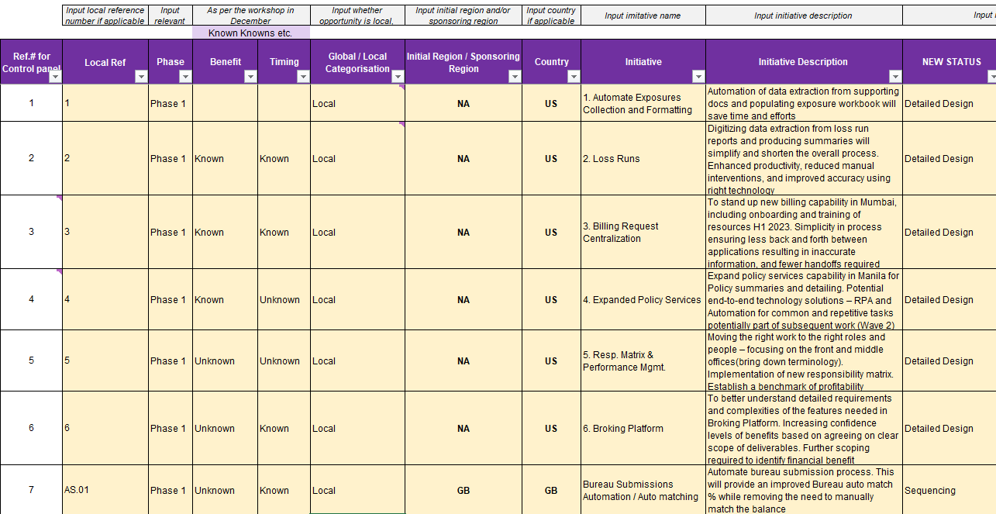
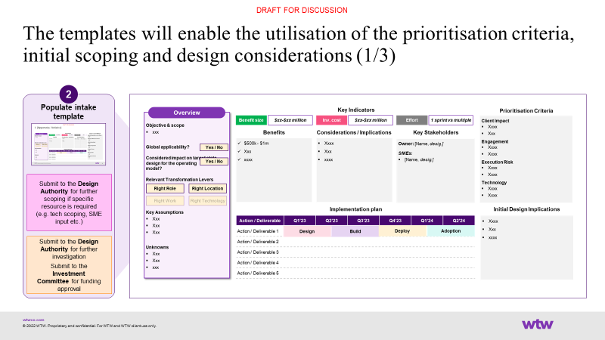
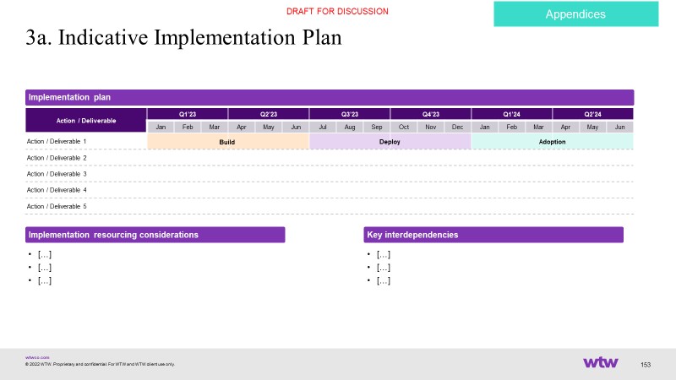
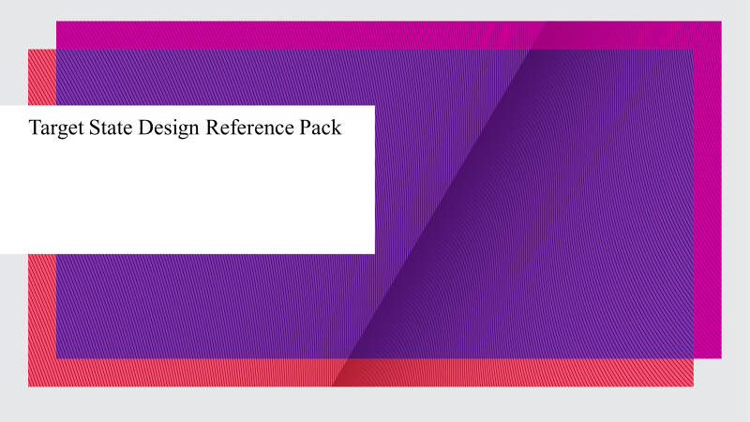

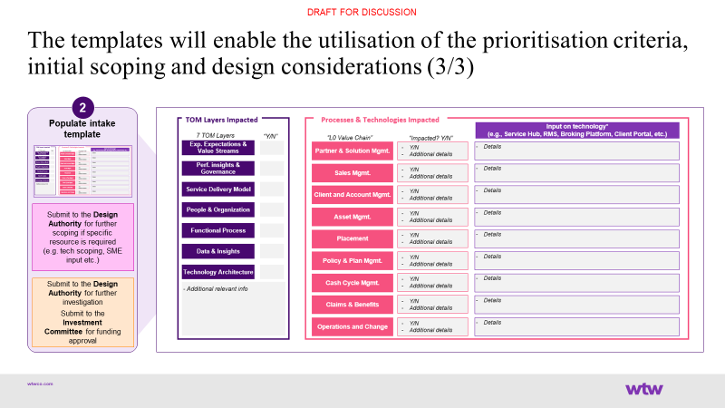
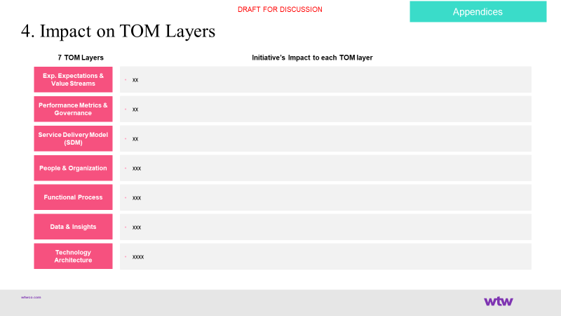
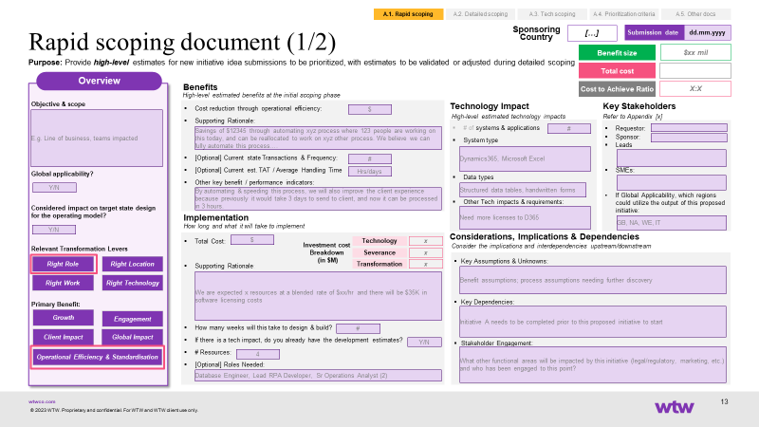
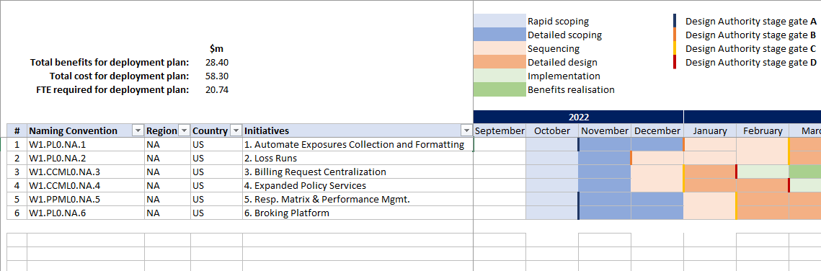
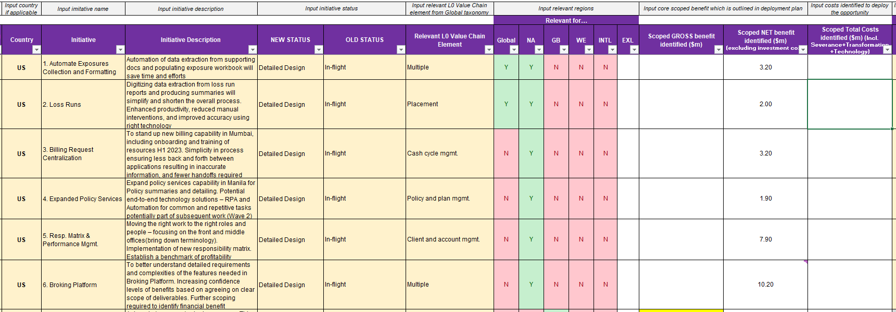
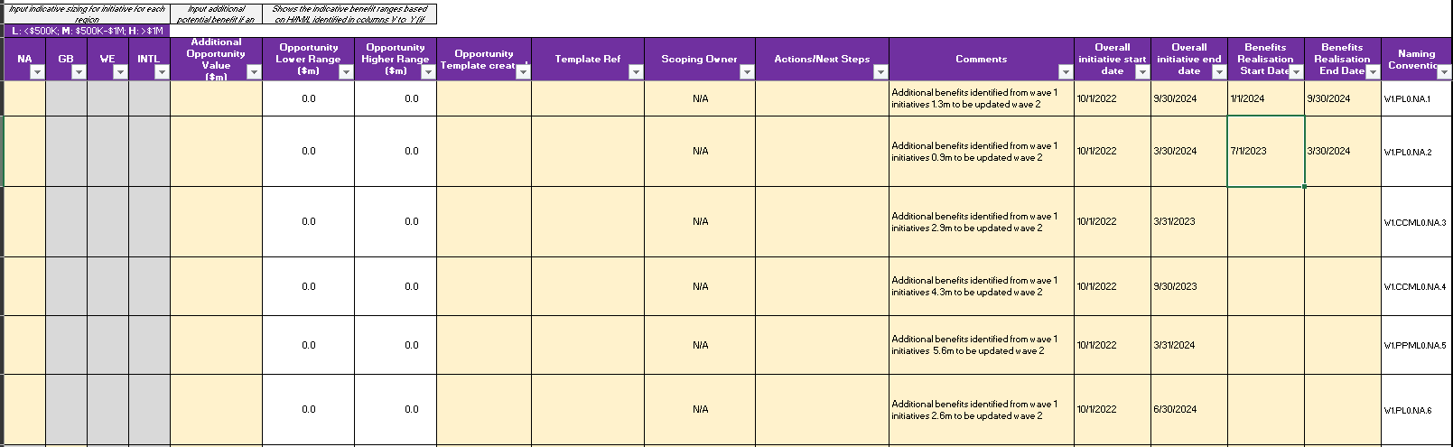
Consulting & Implementation
EXL’s capability toolkit provides the right assets to aid E-2-E digital transformation lifecycle
The control panel acts as ‘single source of truth’ to inform sequencing & prioritization
A
B
C
Stages
Identification & Intake
Rapid Scoping
Detailed Scoping & Sequencing
Detailed Design & Development
Deployment & Adoption
BAU & Benefits realisation, & CI
Supporting Tools
Control Panel
Rapid Scoping Templates
Detailed Scoping Templates & Deployment Plan
Reference Pack & Other Relevant Playbooks
Training Plan
Change Mgmt. & Communication Plan
Readiness Assessment
Benefits Tracking
(incl. incident mgmt., benefits monitoring & CI)
Control Panel – ‘Single Source of Truth’
Newly identified initiatives are recorded in the Control Panel
As the initiative goes through the various stage gates, newly generated information will be added to the Control Panel

Slide 55
Consulting & Implementation
We adopt a structured methodology to prioritize automation opportunities
Process Clustering
Identify and tag processes with similar characteristics
Process Reviews
Process walkthroughs, data collection, re-engineering opportunity identification
Process Scoring
Scoring process (to-be state) on two key axis – Effort and benefits
Process Prioritization
Based on the composite score and subjective inputs from BU
Effort Score
Design complexity:
Inputs - Unique formats and intake sources, standardisation / streamlining potential
Process characteristics – number of tasks, steps, roles etc.
Output – number of reports, alerts etc. required
Integration - number of systems to integrate
Orchestration – number of screens
Process affinity (ability to cross-leverage workflow components built for other tracks)
DEPRIORITISED
STRATEGIC WINS
Effort Score
Benefit Score
Volumes, AHT and FTE size
Expected efficiency gains
Other potential gains – cycle time, quality, CSAT, conversion
LOW HANGING FRUIT
QUICK WINS
Benefit Score

Slide 56
Our differentiated approach to Data and AI led transformation helps clients achieve higher automation value and alignment with Target Operating Model
Our Approach to Low-code Automation
1. Data led discovery
2. Journey reimagination
3. Upstream AI
4. Data flow Automation
5. Human in Loop
Analysis of enterprise processes (or tasks)
to create a baseline
Customer led outside in approach to design right customer journey and process
Converting unstructured / semi-structured data into structured data
Streamline data flow across
systems
Human validation with domain context
Structured / Unstructured / Semi-structured
Domain Led design thinking
Native automation
API (REST/SOAP)
Webhooks, Connectors
AI Powered content extraction
Validation for accurate outcomes
Domain expertise
Process automation
Data Automation
Workflow Automation
RPA
Gen AI Assist
Business Process Reengineering
AI led CX Engagement Layer
Process/Task mining & monitoring
AI Powered Decision Models
Decision & data analytics
Insights
Proactive nudges
Recommendations
Low Code No Code Workflow
Experience design (CX/UX)
Data Engineering, Management and Data Governance
Program and Change Management
EXL drives 4 business outcomes for clients by powered by our proven accelerators, solutions and capability COEs

Slide 57





EXL’s approach to end-to-end process redesign and automation combining data engineering and workflow application
Our Approach to Low-code Automation
Low-code platform for building data-centric digital apps
Multiple Data Channels
Multiple Data Channels
Multi-system
Integration & Ingestion
Data
Transformation & Management
Business Rules, Workflow, Accelerators, UI
Insights
& Reporting
Multiple Data Formats
Multiple Data Formats
Multiple Data Sources/ Systems
Multiple Data Sources/ Systems
Data Engineering
Workflow Application
Data unification, OOB connectors/API, Taxonomy & hierarchy management, data quality and audit, rules engine
AI / ML enabled data ingestion to deliver clean data upstream
Process optimization and re-engineering
Target Operating Model design
Data processing, end to end automation features & capabilities - BPM, RPA, decision engine, workflow
Integration with analytics engine to drive decision automation and insights

